Slide 1
Notes:
You may already have the tools needed to take fantastic photos
low budget with great results
this seminar will focus on digital photography
- Importance of Documenting your Work
- Archival Purposes
- Marketing
- Sales
- Shows
- Grants
- Equipment
- Camera vs Phone
- Lights
- Stage
- Pre Production
- Artificial vs Natural Light
- Modeled vs Object
- Piece Prep
- Cleaning
- Propping
- Roll Call
- Production
- Before Pressing the button
- Camera Settings
- Raw vs JPEG
- Click Away
- Post Production
- File management
- Program
- Photoshop vs Photos vs Mobile
- Retouching
- Camera Raw
- Imperfections
- Background fixes
- Adjustment Layers
- Brightness
- Curves
- Saturation/Hue
- Exporting
-Questions

Slide 2
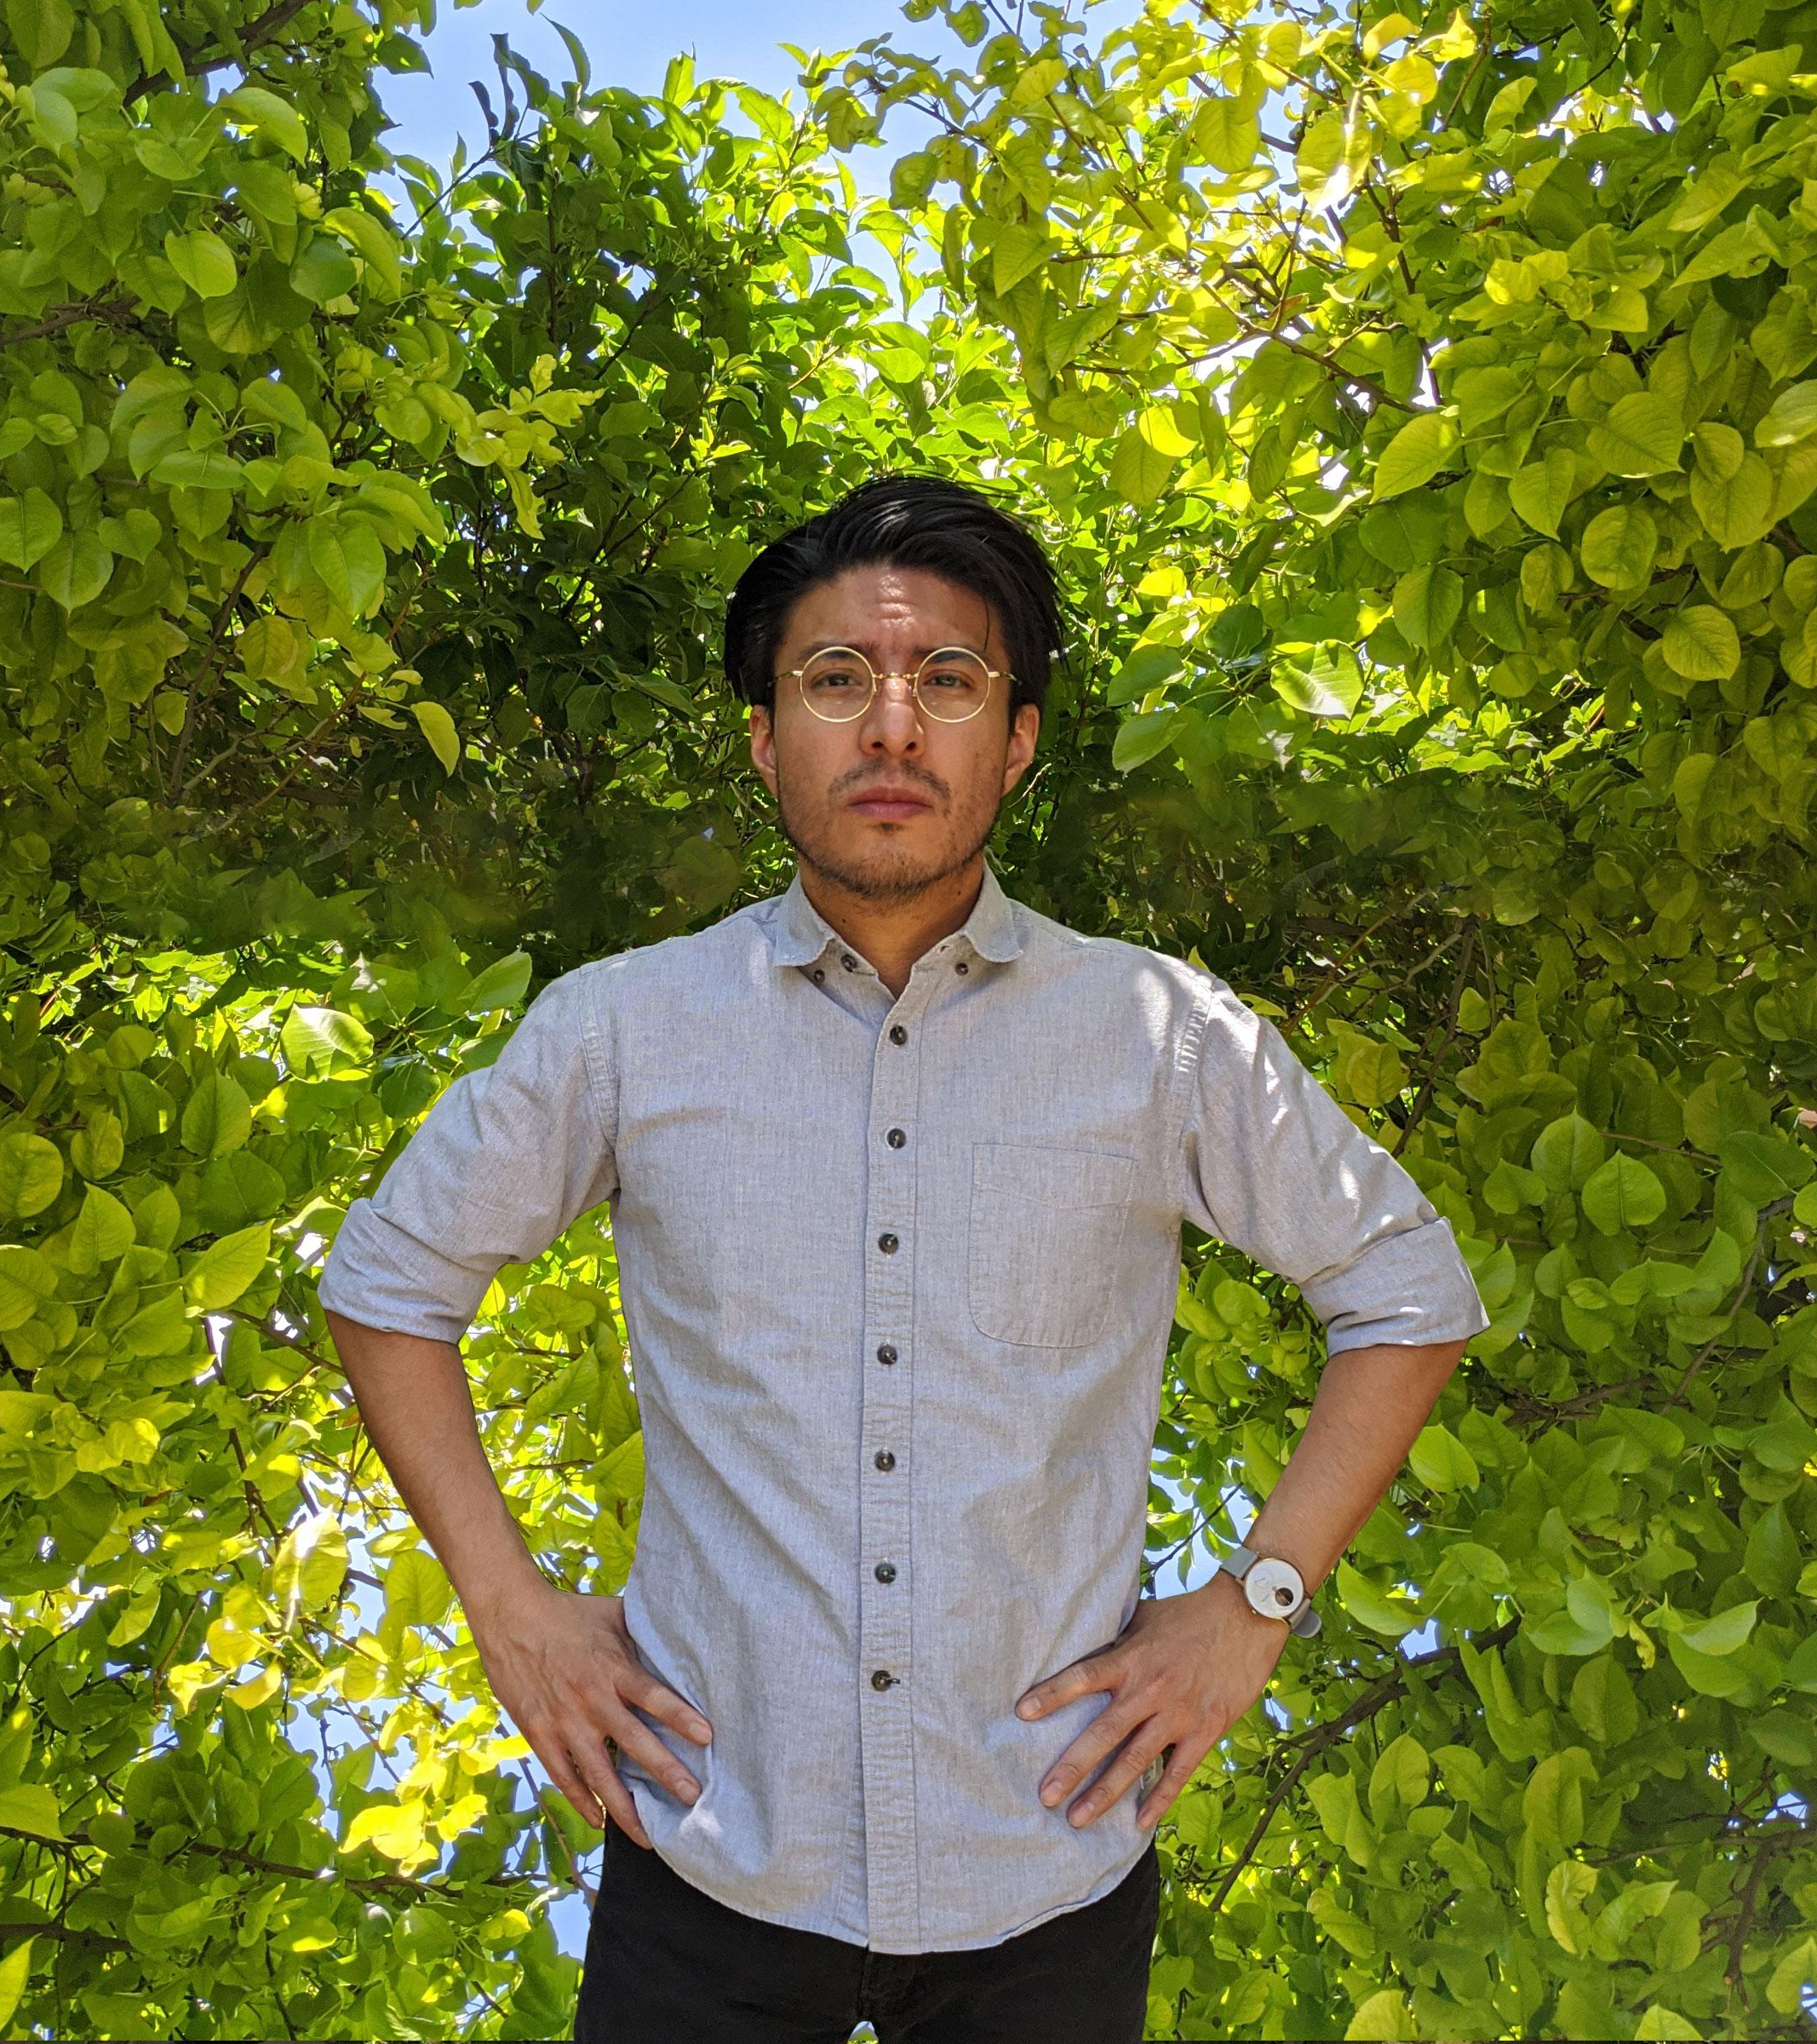
Jorge Calleja
Graphic Designer
Web Developer
Photographer?
UTEP
The Art Avenue
Las Artistas
Notes:
Currently a Graphic designer at The University of Texas at El Paso, advancing the university brand
Creative director at The Art Avenue, a local art and culture magazine and worked closely with artists from a wide variety of mediums

Slide 3
What do you need to take a great photo?
Notes:
What do you need to take a great photo?
Time
Time to prepare yourself
Time to prepare your equipment
Time to prepare your image
Because the real work really is just preparing for the shot
So prepare, that way editing your image won’t take more than 5 mins

Slide 4
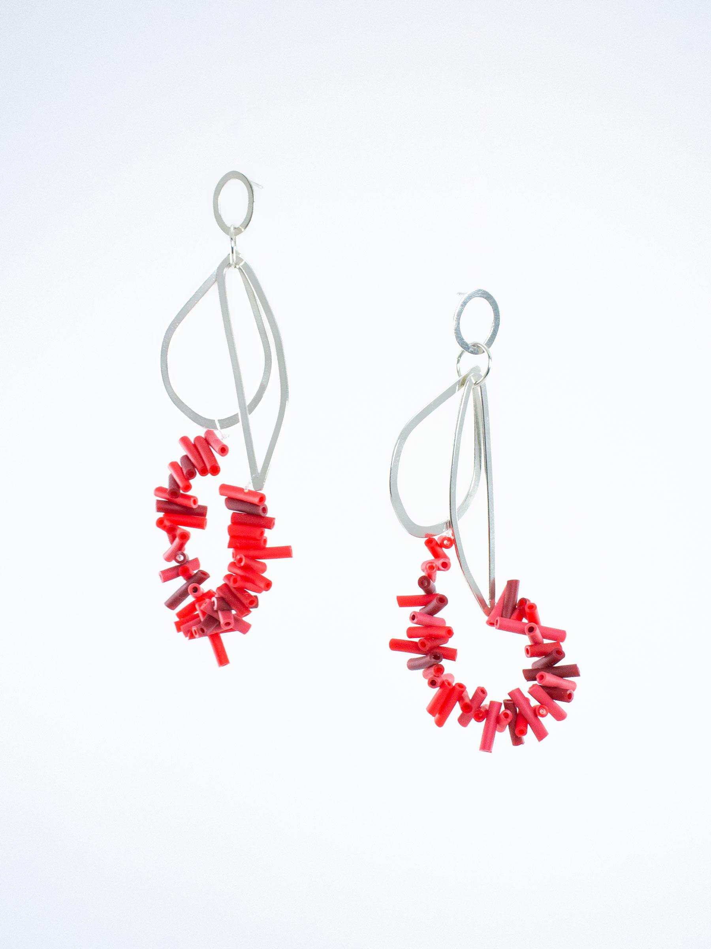
outline
Purpose
Equipment
Pre-production
Production
Post-production
Criselda Lopez 2019
Notes:
Why are you taking photos?
What kind of equipment do you have and what you may need
What to do before
during
and after a photoshoot

Slide 5
purpose
Online sales
Print
Grants
Social Media
Helen Ellison Dorion 2017
Notes:
Why do you need to photograph your work?
Depending on the answer you may have to adjust your mentality about how to approach the shot
Online sales - Showcase details
Print - high resolution images
Grants - process of making your pieces
Social media - model shots, or show your piece within context

Slide 6
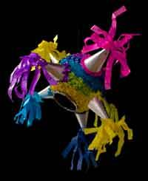
image specs
Size
Resolution
Format
Jorge Calleja? Should’ve paid attention to the specs
Notes:
Regardless of the purpose you need to know in advance specs
Size
Resolution
Format
Print
Inches
300 ppi
Tiff eps and jpeg
Online
Pixels
72 ppi - although I’ve been more comfortable with 90 ppi
JPEG & PNG
Online platforms at least 1080 x 1080 px it will look good

Slide 7
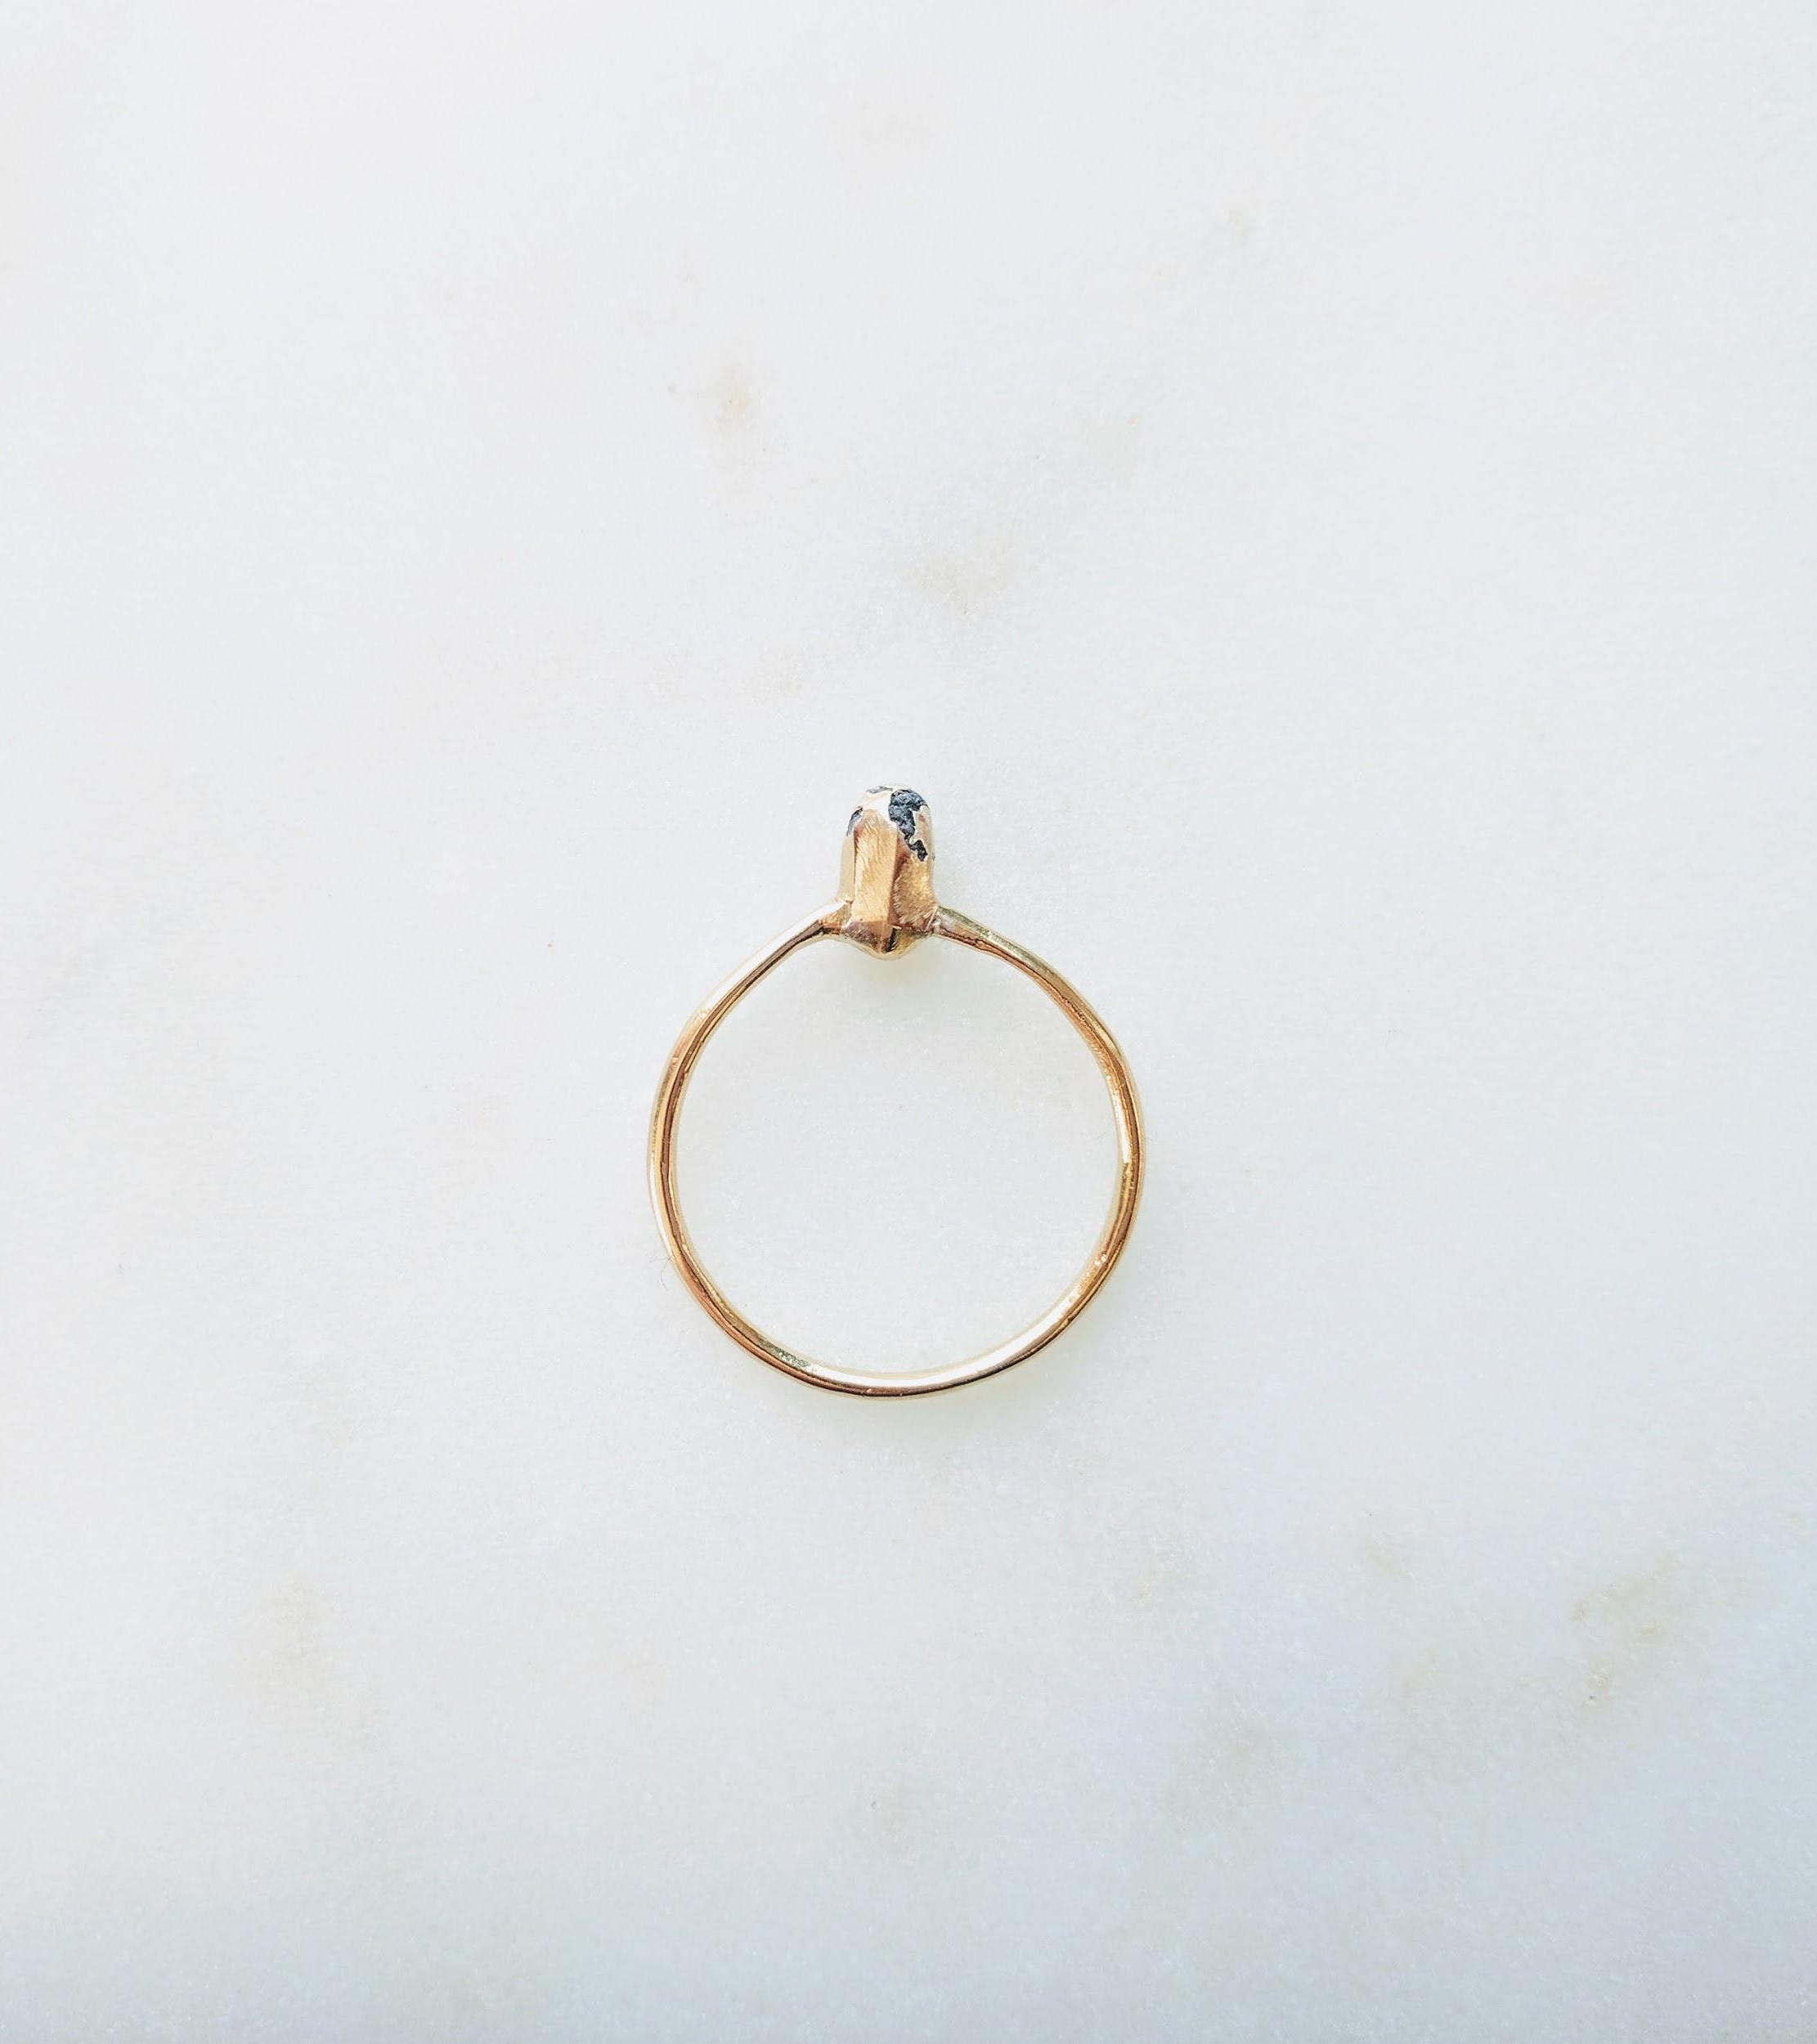
equipment
Camera vs Phone
Lighting
Stage
Accessories
Haydee Alonso 2017
Notes:
you do need professional equipment to take professional photos, just ingenuity
Learn how to use your equipment
it’s limitations and how to circumvent them
if something is not working for you, change your strategy, try something else

Slide 8
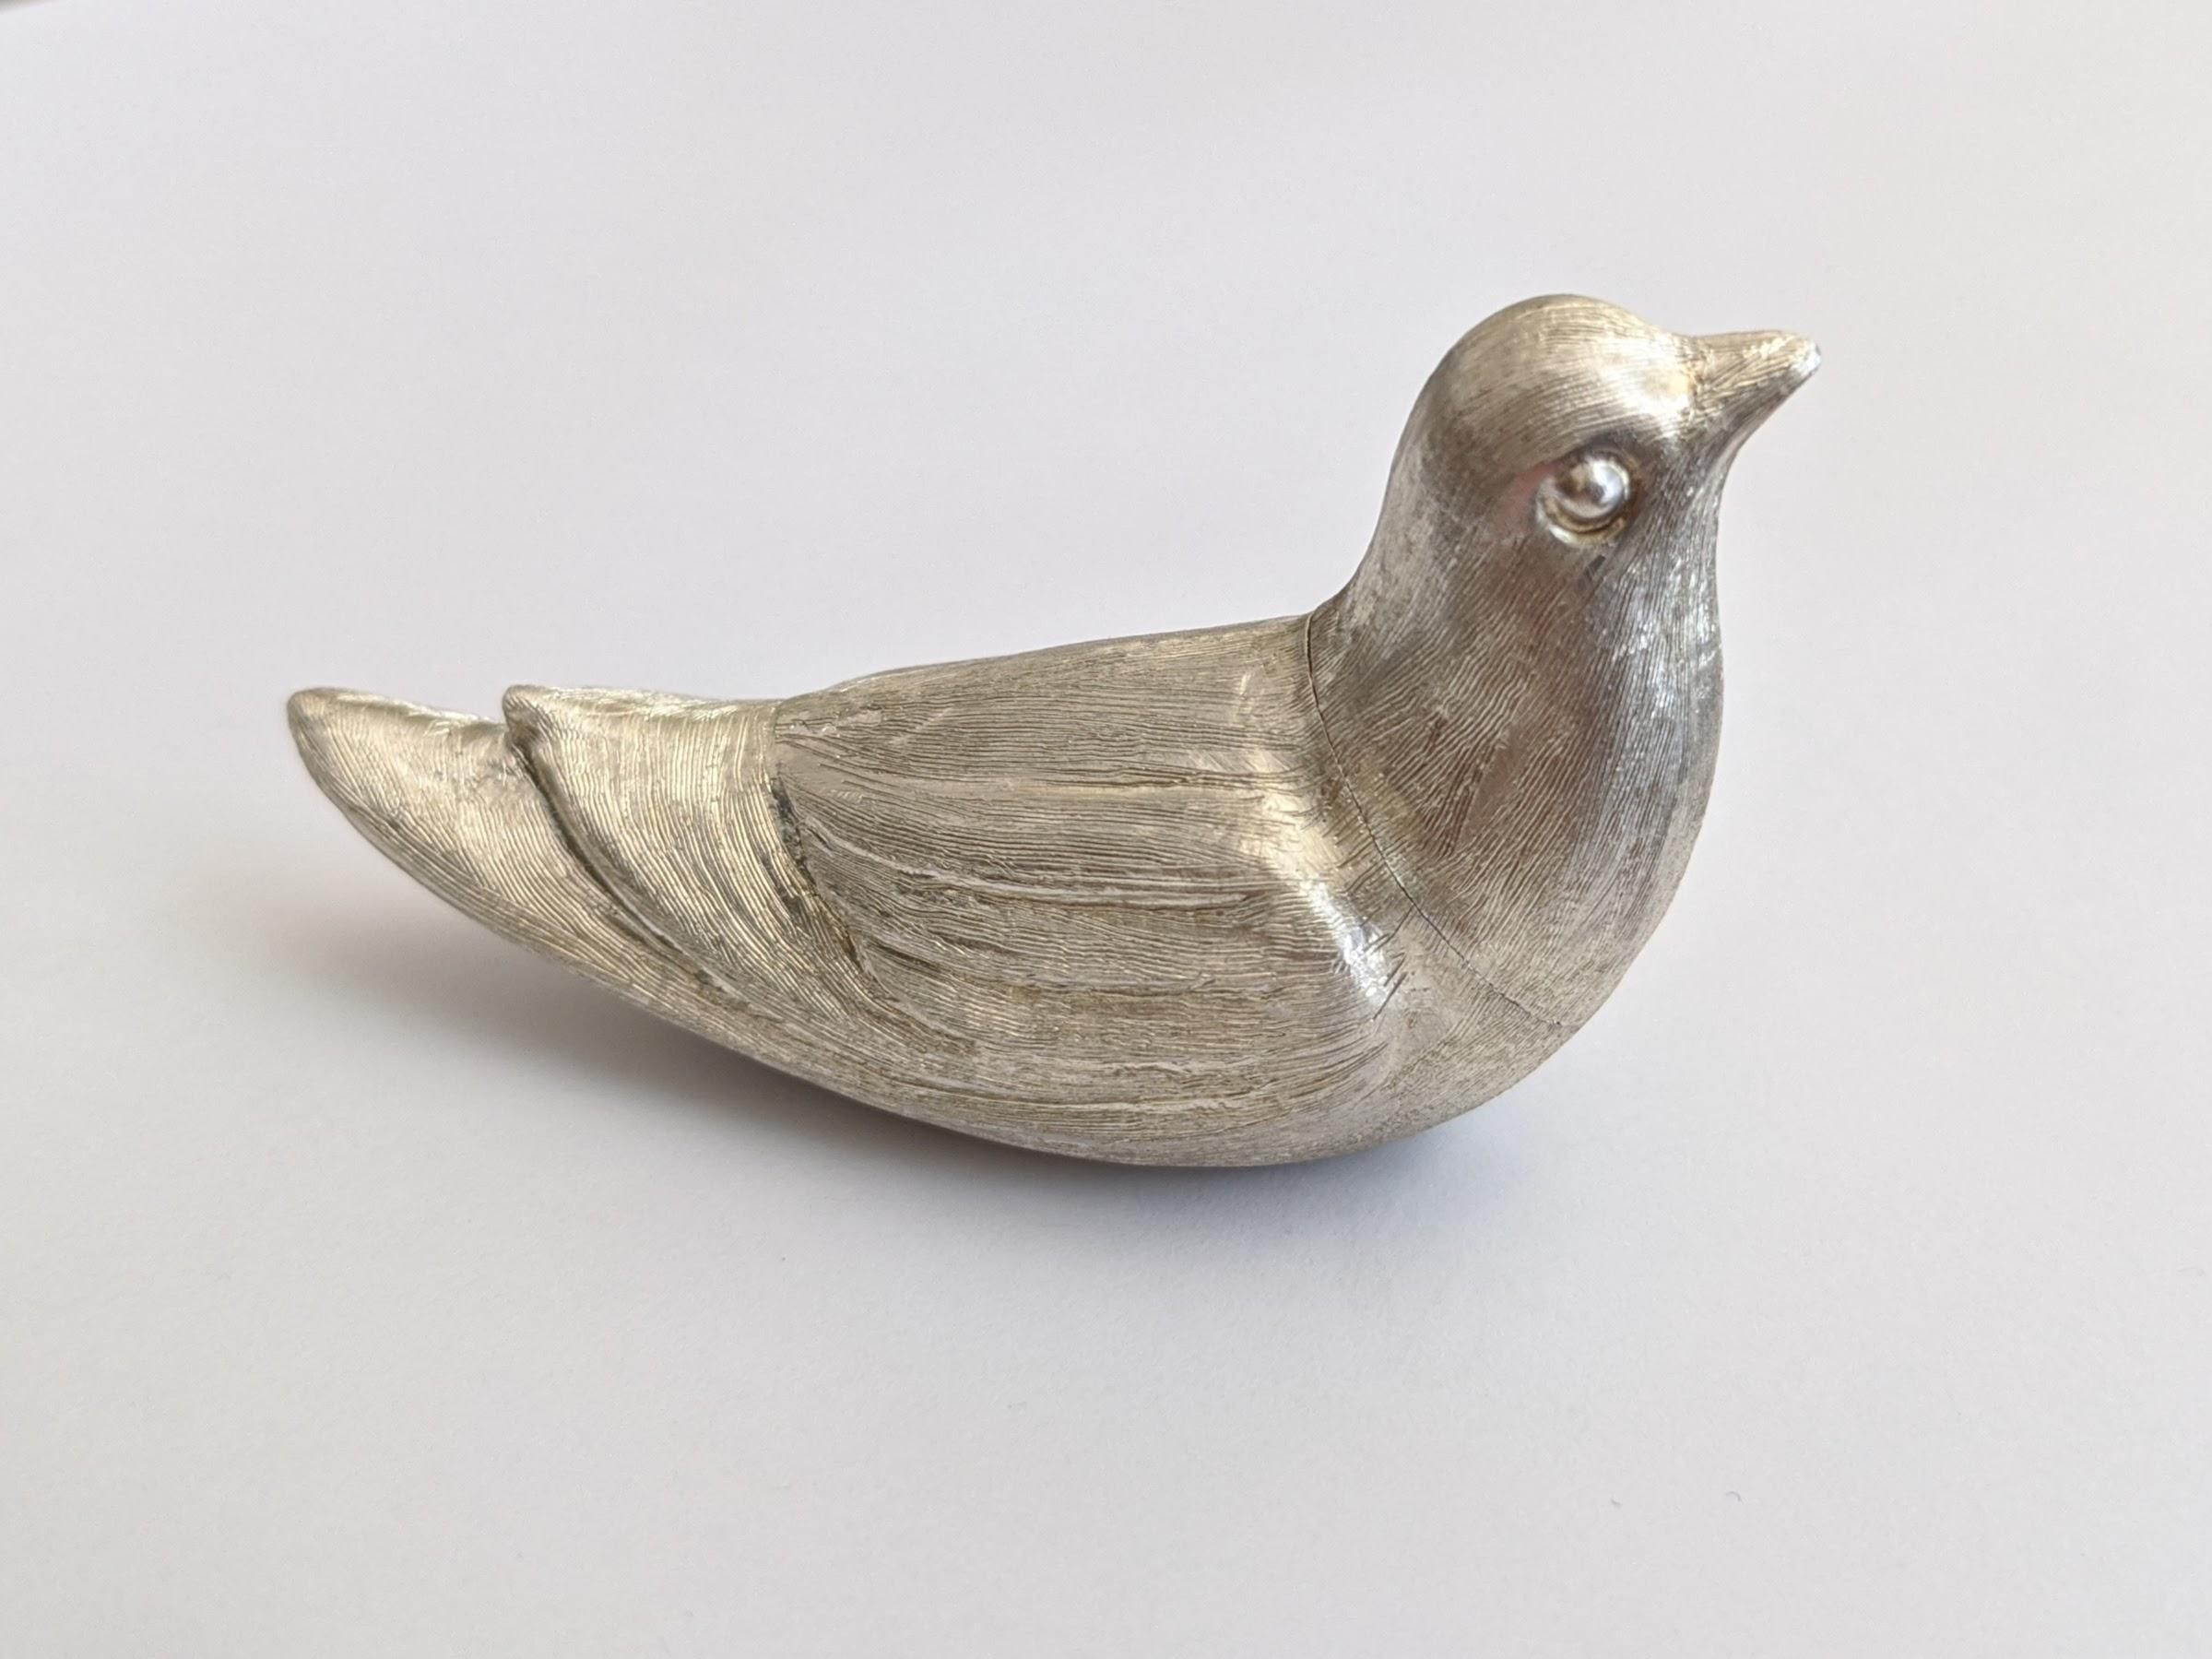
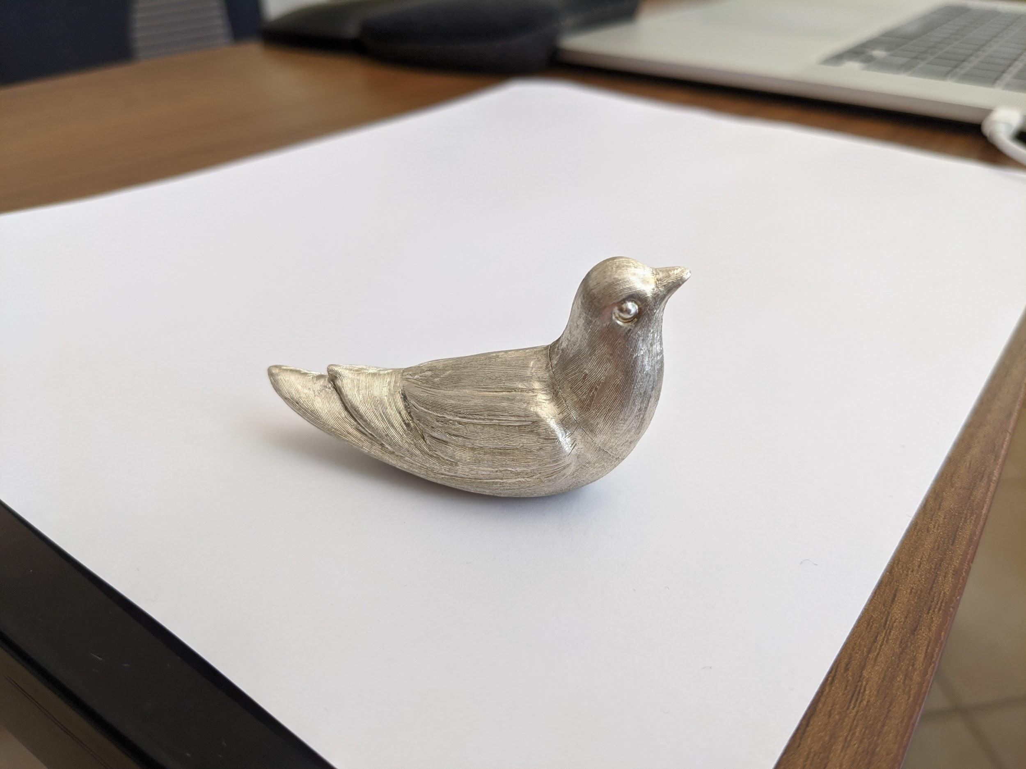
camera vs phone
Price
Availability
Specialized tool
Settings
Quality
Lenses
Nava 2020
Notes:
What’s best, a professional camera or a phone?
This is a loaded
if you have a camera that’s 5~6 years old or got a phone within the last 4 years
chances are you already have a competent camera
If you are serious about opening an online shop, a camera or newer phone is a good investment
You don’t have to buy it brand new or latest model but something in the 450~550 is recommended shop for a deal
a camera viewed as an investment pays itself after 20 images produced
the image you see is from my phone couple of days ago, unedited, just cropped, natural light, background is a piece of paper
Phones are great, they are within arms reach
Not to mention you can buy lens kits for your phone to enhance their capabilities
On a phone Auto settings are pretty good, but my camera lets me fine tune the shot
It’s not which one is better
Key is learning how to use them and recognize what tool is best for the job

Slide 9
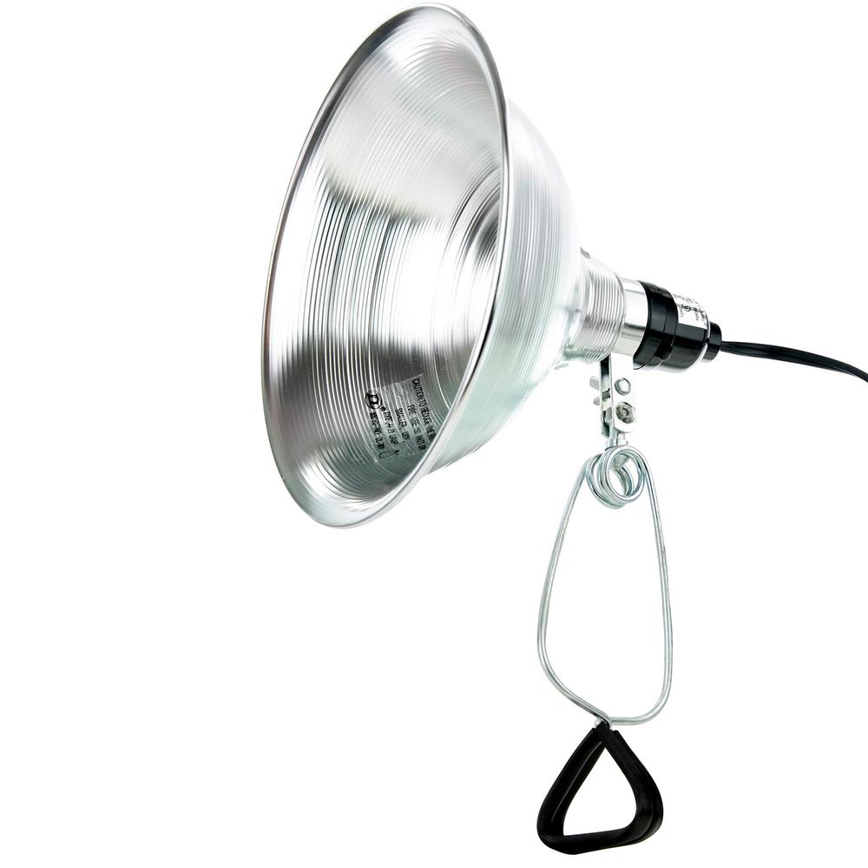
lighting
Lamps
Bulbs
Stands
Power stripe
Screens
Clamp Lamp $15 or less at a garage sale
Notes:
If you are serious about building a studio, lighting will be essential
It is critical that you learn how to control the light and how it interacts with your piece
For bulbs I use CFL
if you are planning on using a phone and a lightbox I would consider LED,
they are a bit more expensive but streaking is not an issue with the rolling shutter on phones
Stands or somewhere to clamp your lamps, chairs poles, other lamps
Power stripe or surge protector
Reflective white cloth to diffuse and reflect light

Slide 10
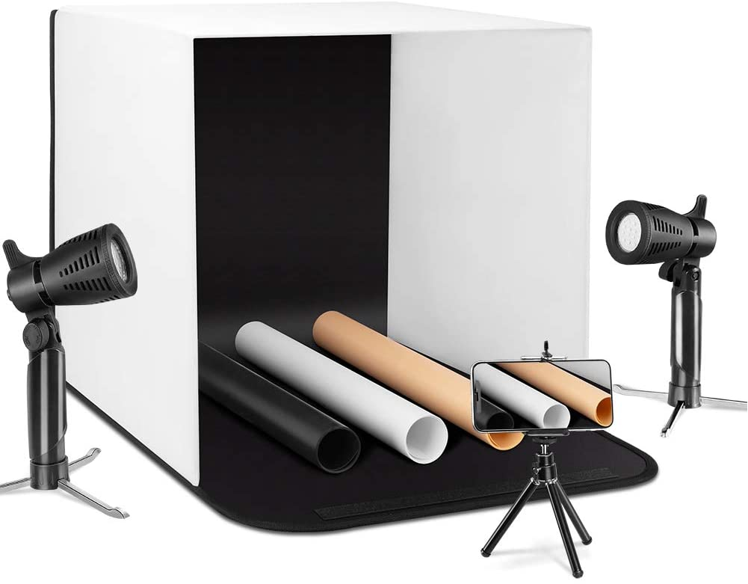
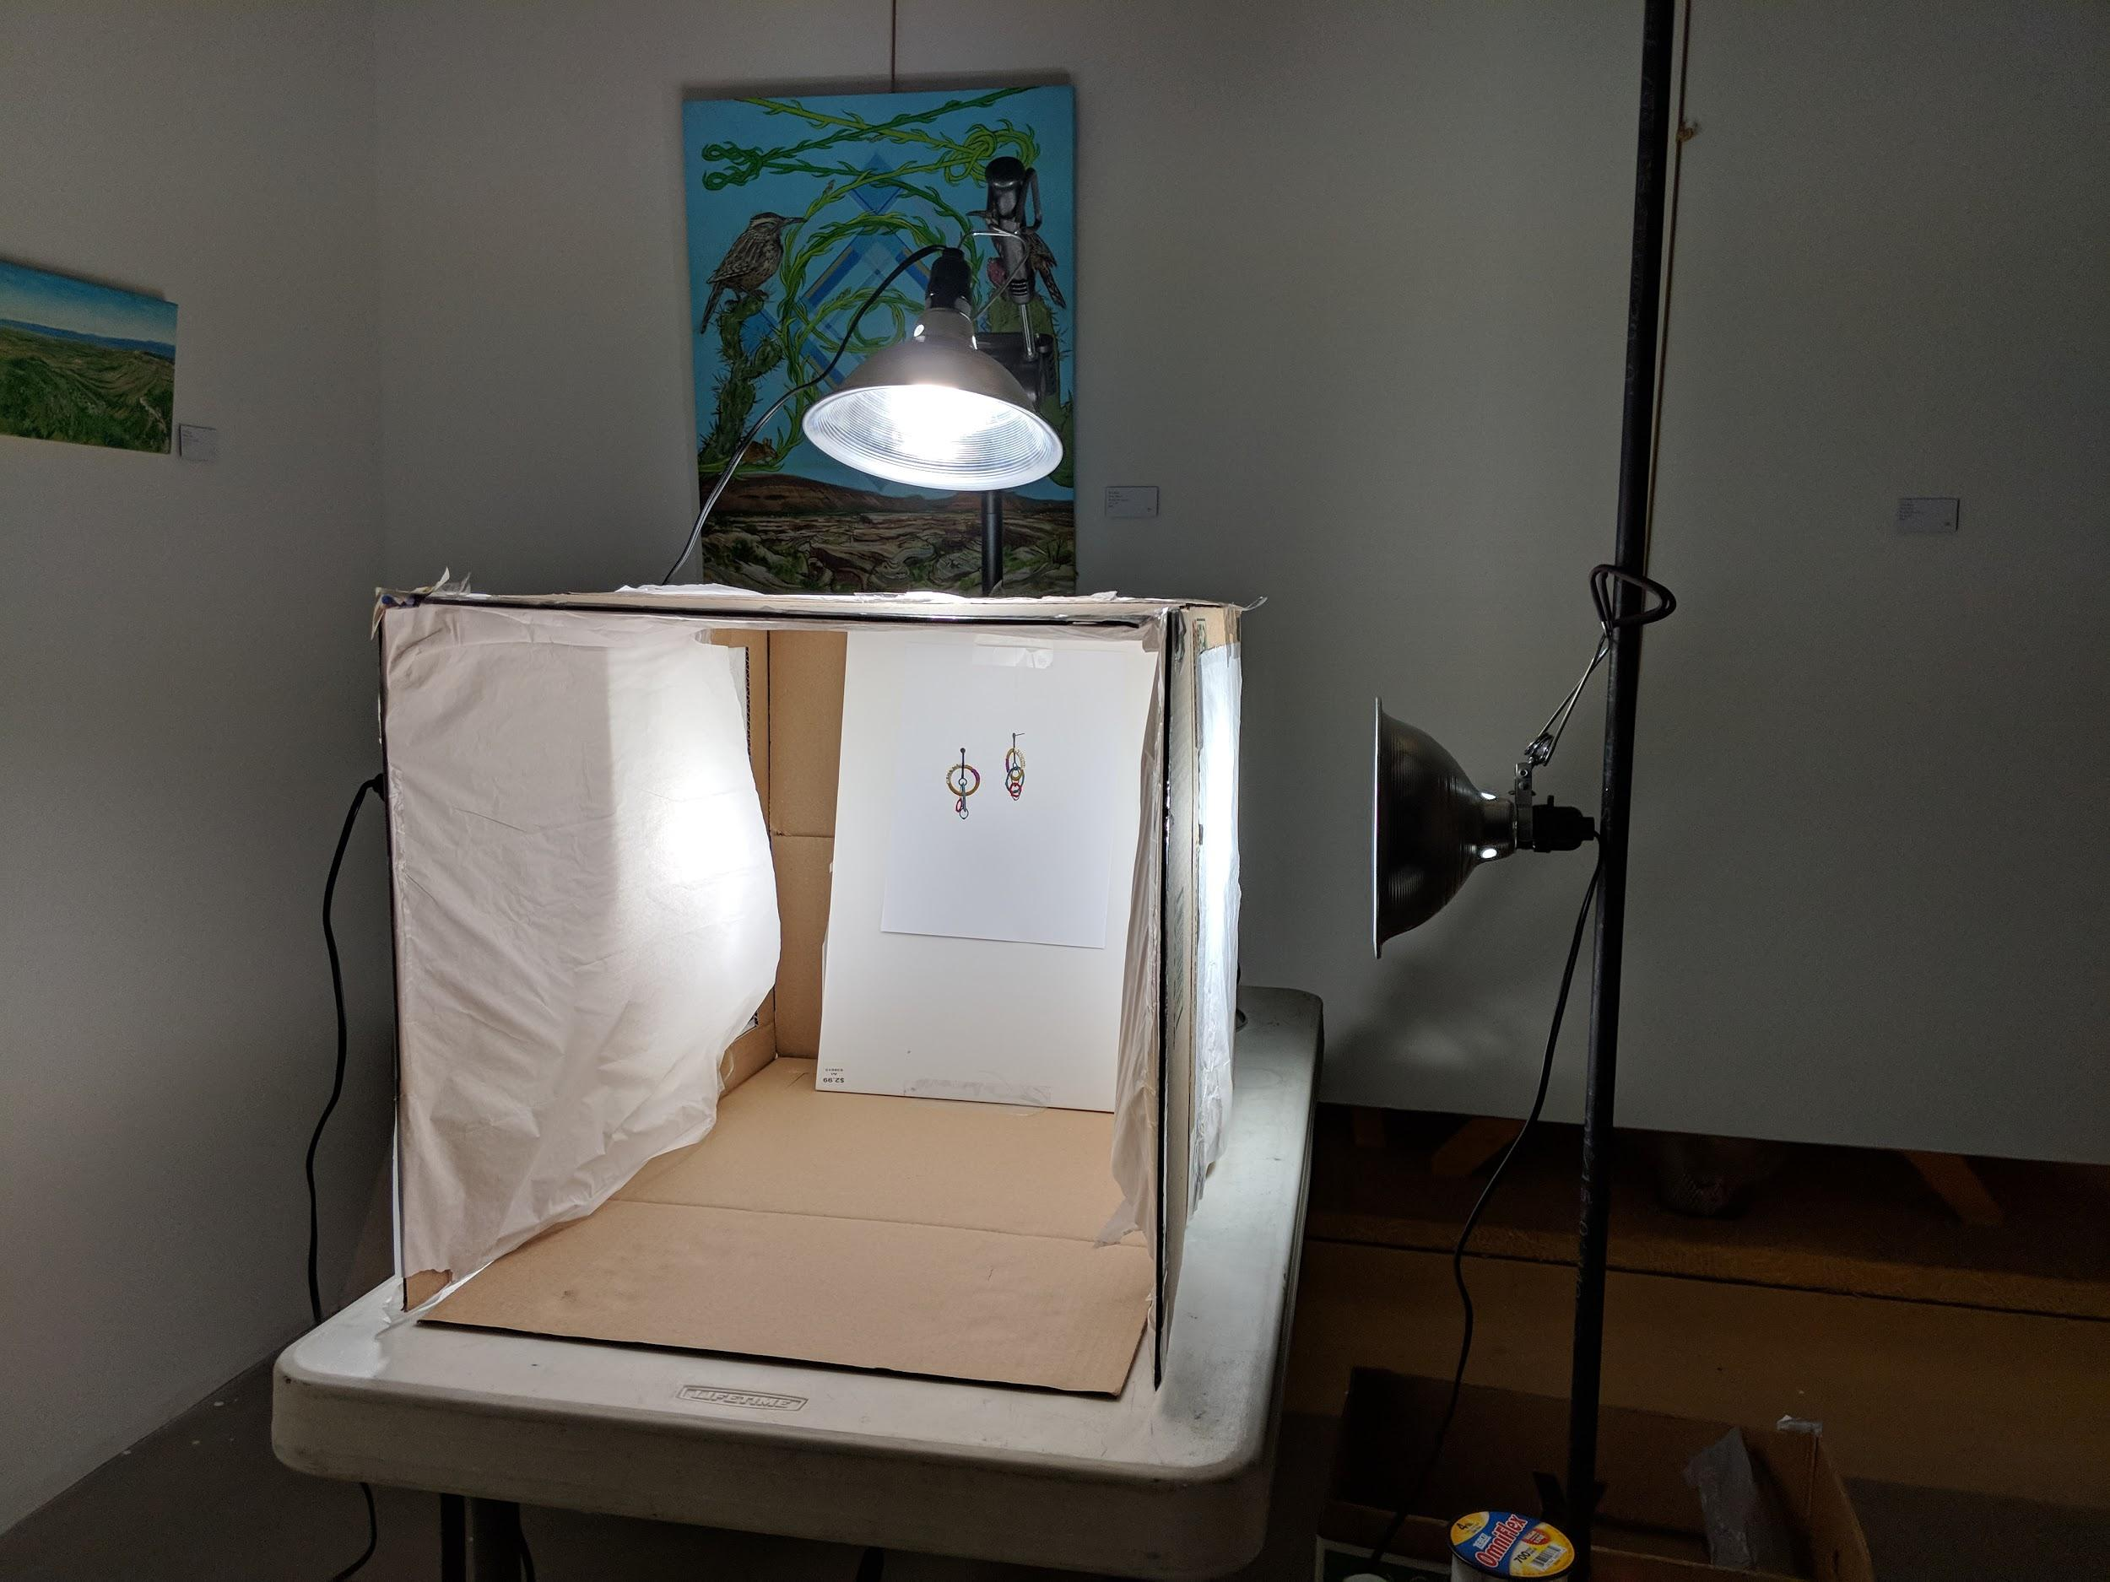
stage
Cardboard box
Lightbox kits
Studio setting
Notes:
For smaller pieces you might want to consider a lightbox
This helps control the light, not only by illuminating appropriately it also helps to keep light out
What I mean is always use the same kind of light, if you mix bulbs, temperature, wattage, it will show in your image and that’s really hard to edit
Keep it to 1 kind of lighting
You can make yourself a lightbox out of a cardboard box
This is a nice video showing you how, basically you get a box, cut three squares, put tissue paper on said wholes and you have yourself a lightbox
https://www.youtube.com/watch?v=tUjWL0Vl9VY
If you need more of a studio setting for life size models you can get a roll of paper for 15 bucks, either black/white
whichever suits your piece
tape it to the wall let it drape on the floor have the model is standing on the paper and you are in business

Slide 11
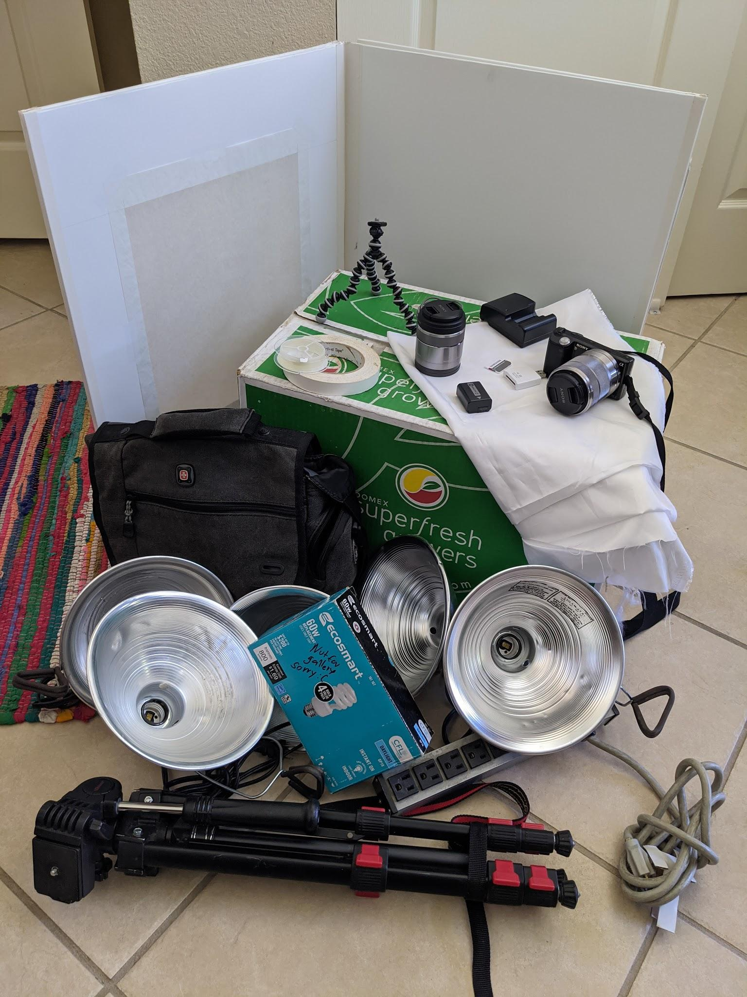
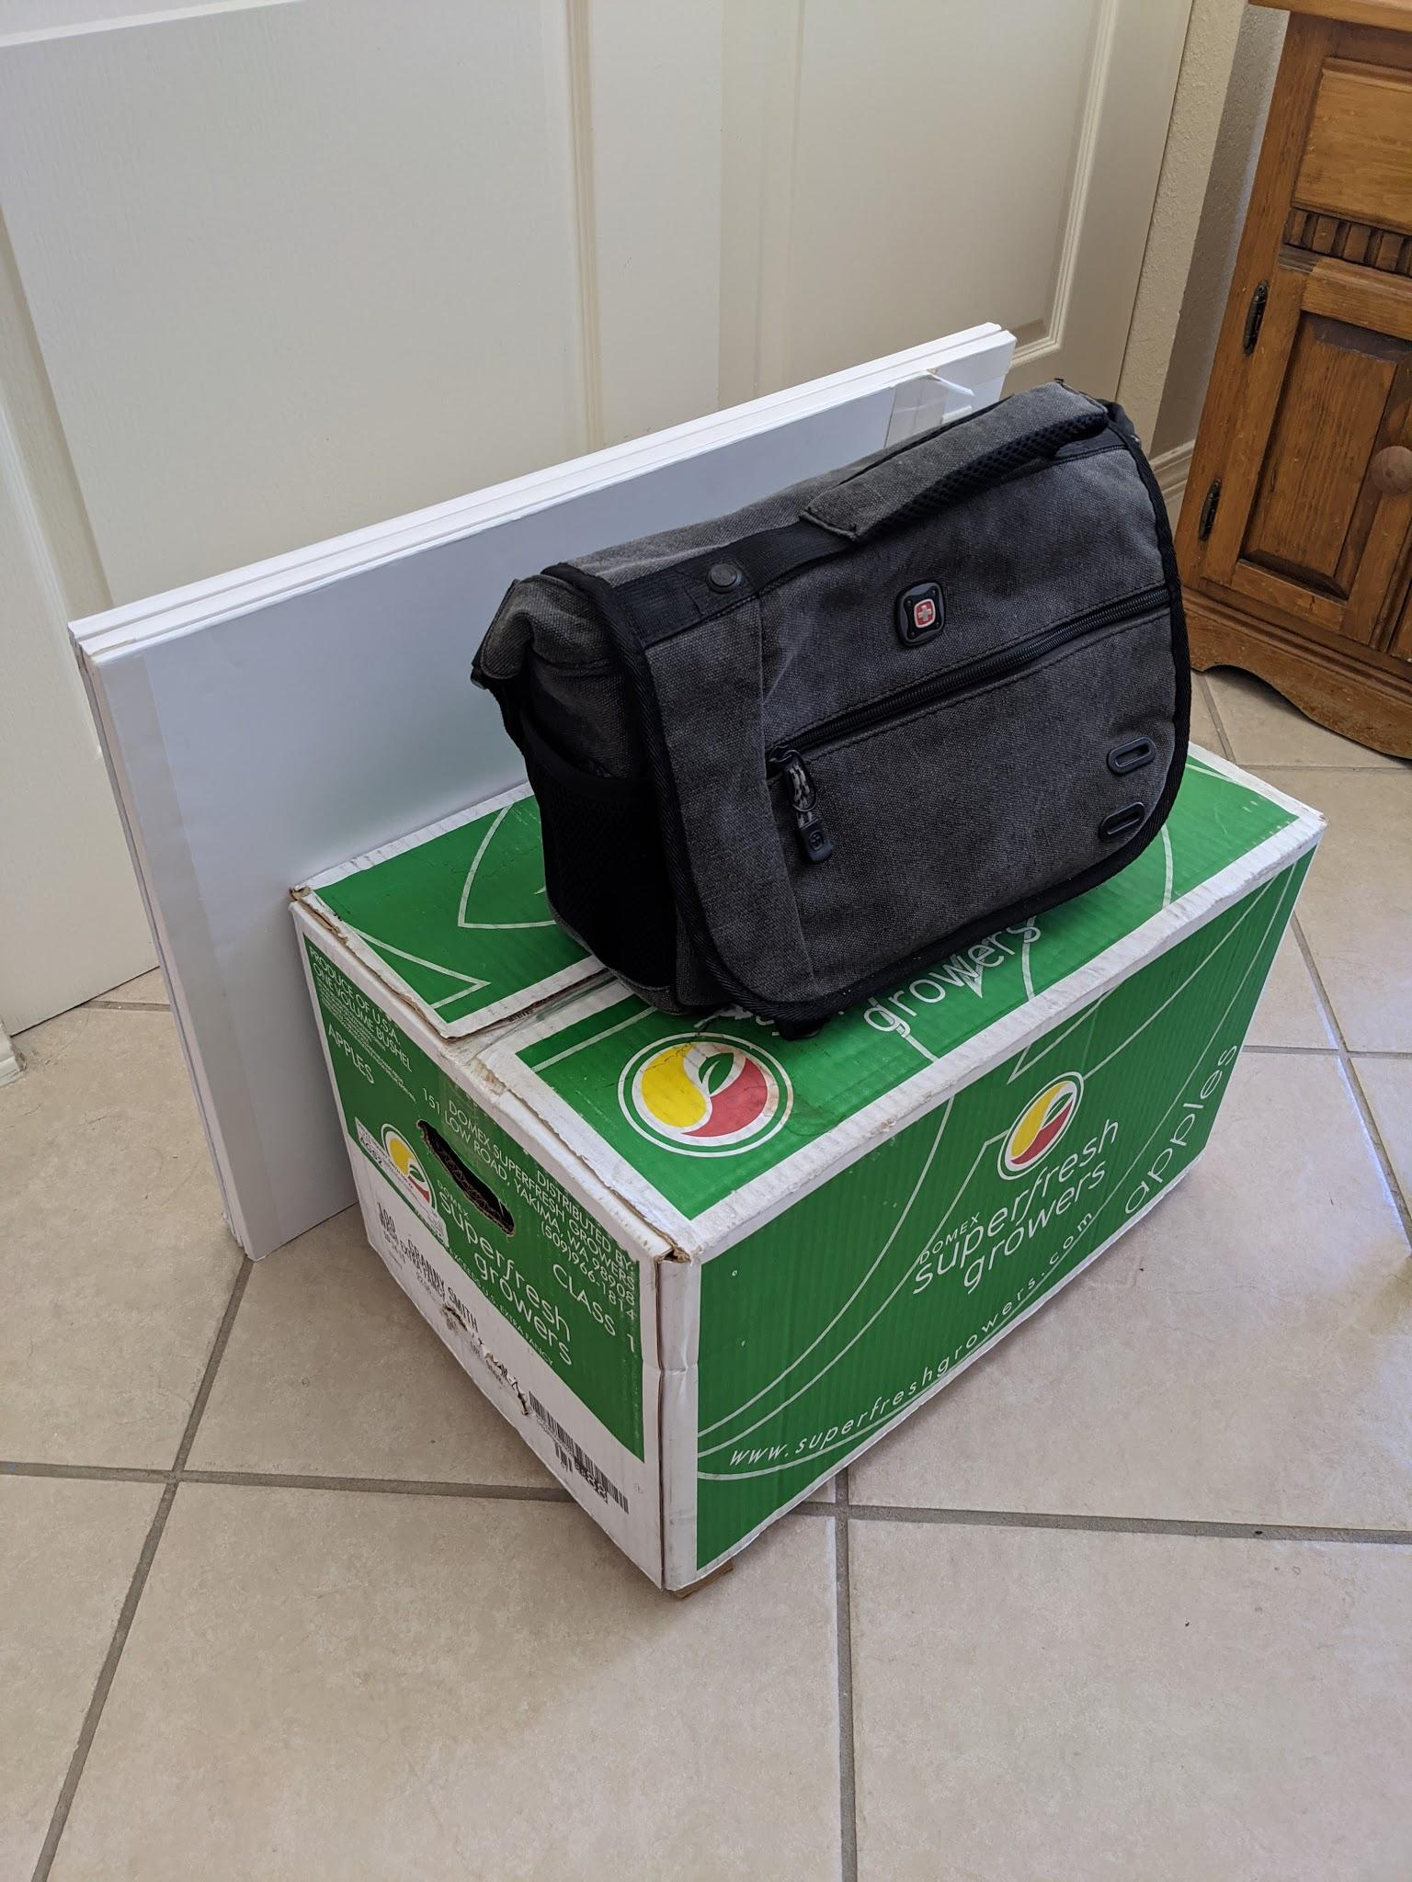
accessories
Tripod
Remote
Misc
Notes:
Accessories
Tripod
If you don’t want to buy one these borrow one
If you are a student chances are technology labs and libraries let you check out one for a couple of days
a remote control to take pictures without having to worry about shaking the camera
otherwise using a 2 second timer should do the trick.
Misc: tape, thumbtacks, pieces of cardboard, paper, fishing line, towels, scissors, safety pins, all these things come in handy for propping and staging your piece not to mention wardrobe malfunctions

Slide 12
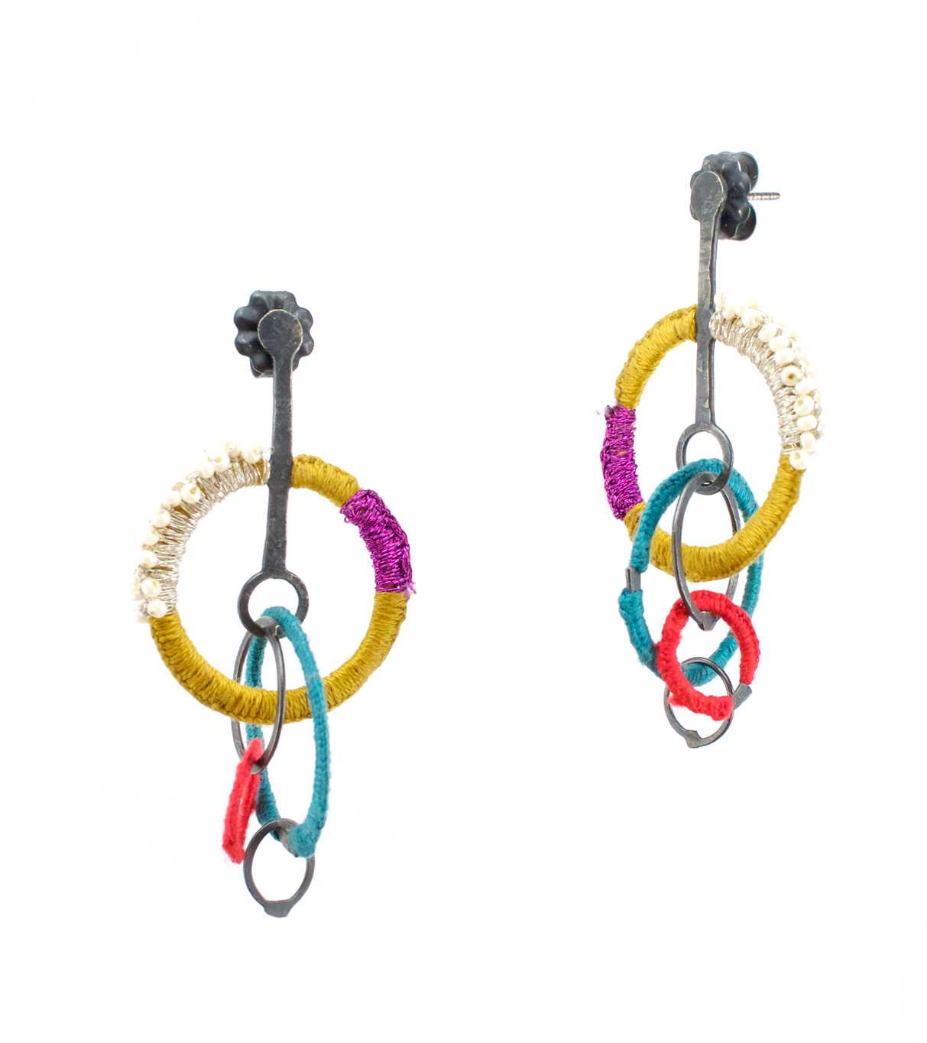
pre-production
Modeled vs Object
Artificial vs Natural Light
Piece prep
Helen Ellison Dorion 2017
Notes:
think how the shot is going to look
So go back to the purpose of the photograph
What’s your vision, how does the final image looks in your mind
Then ask yourself these questions
Do I need a model or just lay down the piece
Does a lightbox work or do I want this to be outside
What other special considerations does my piece needs

Slide 13
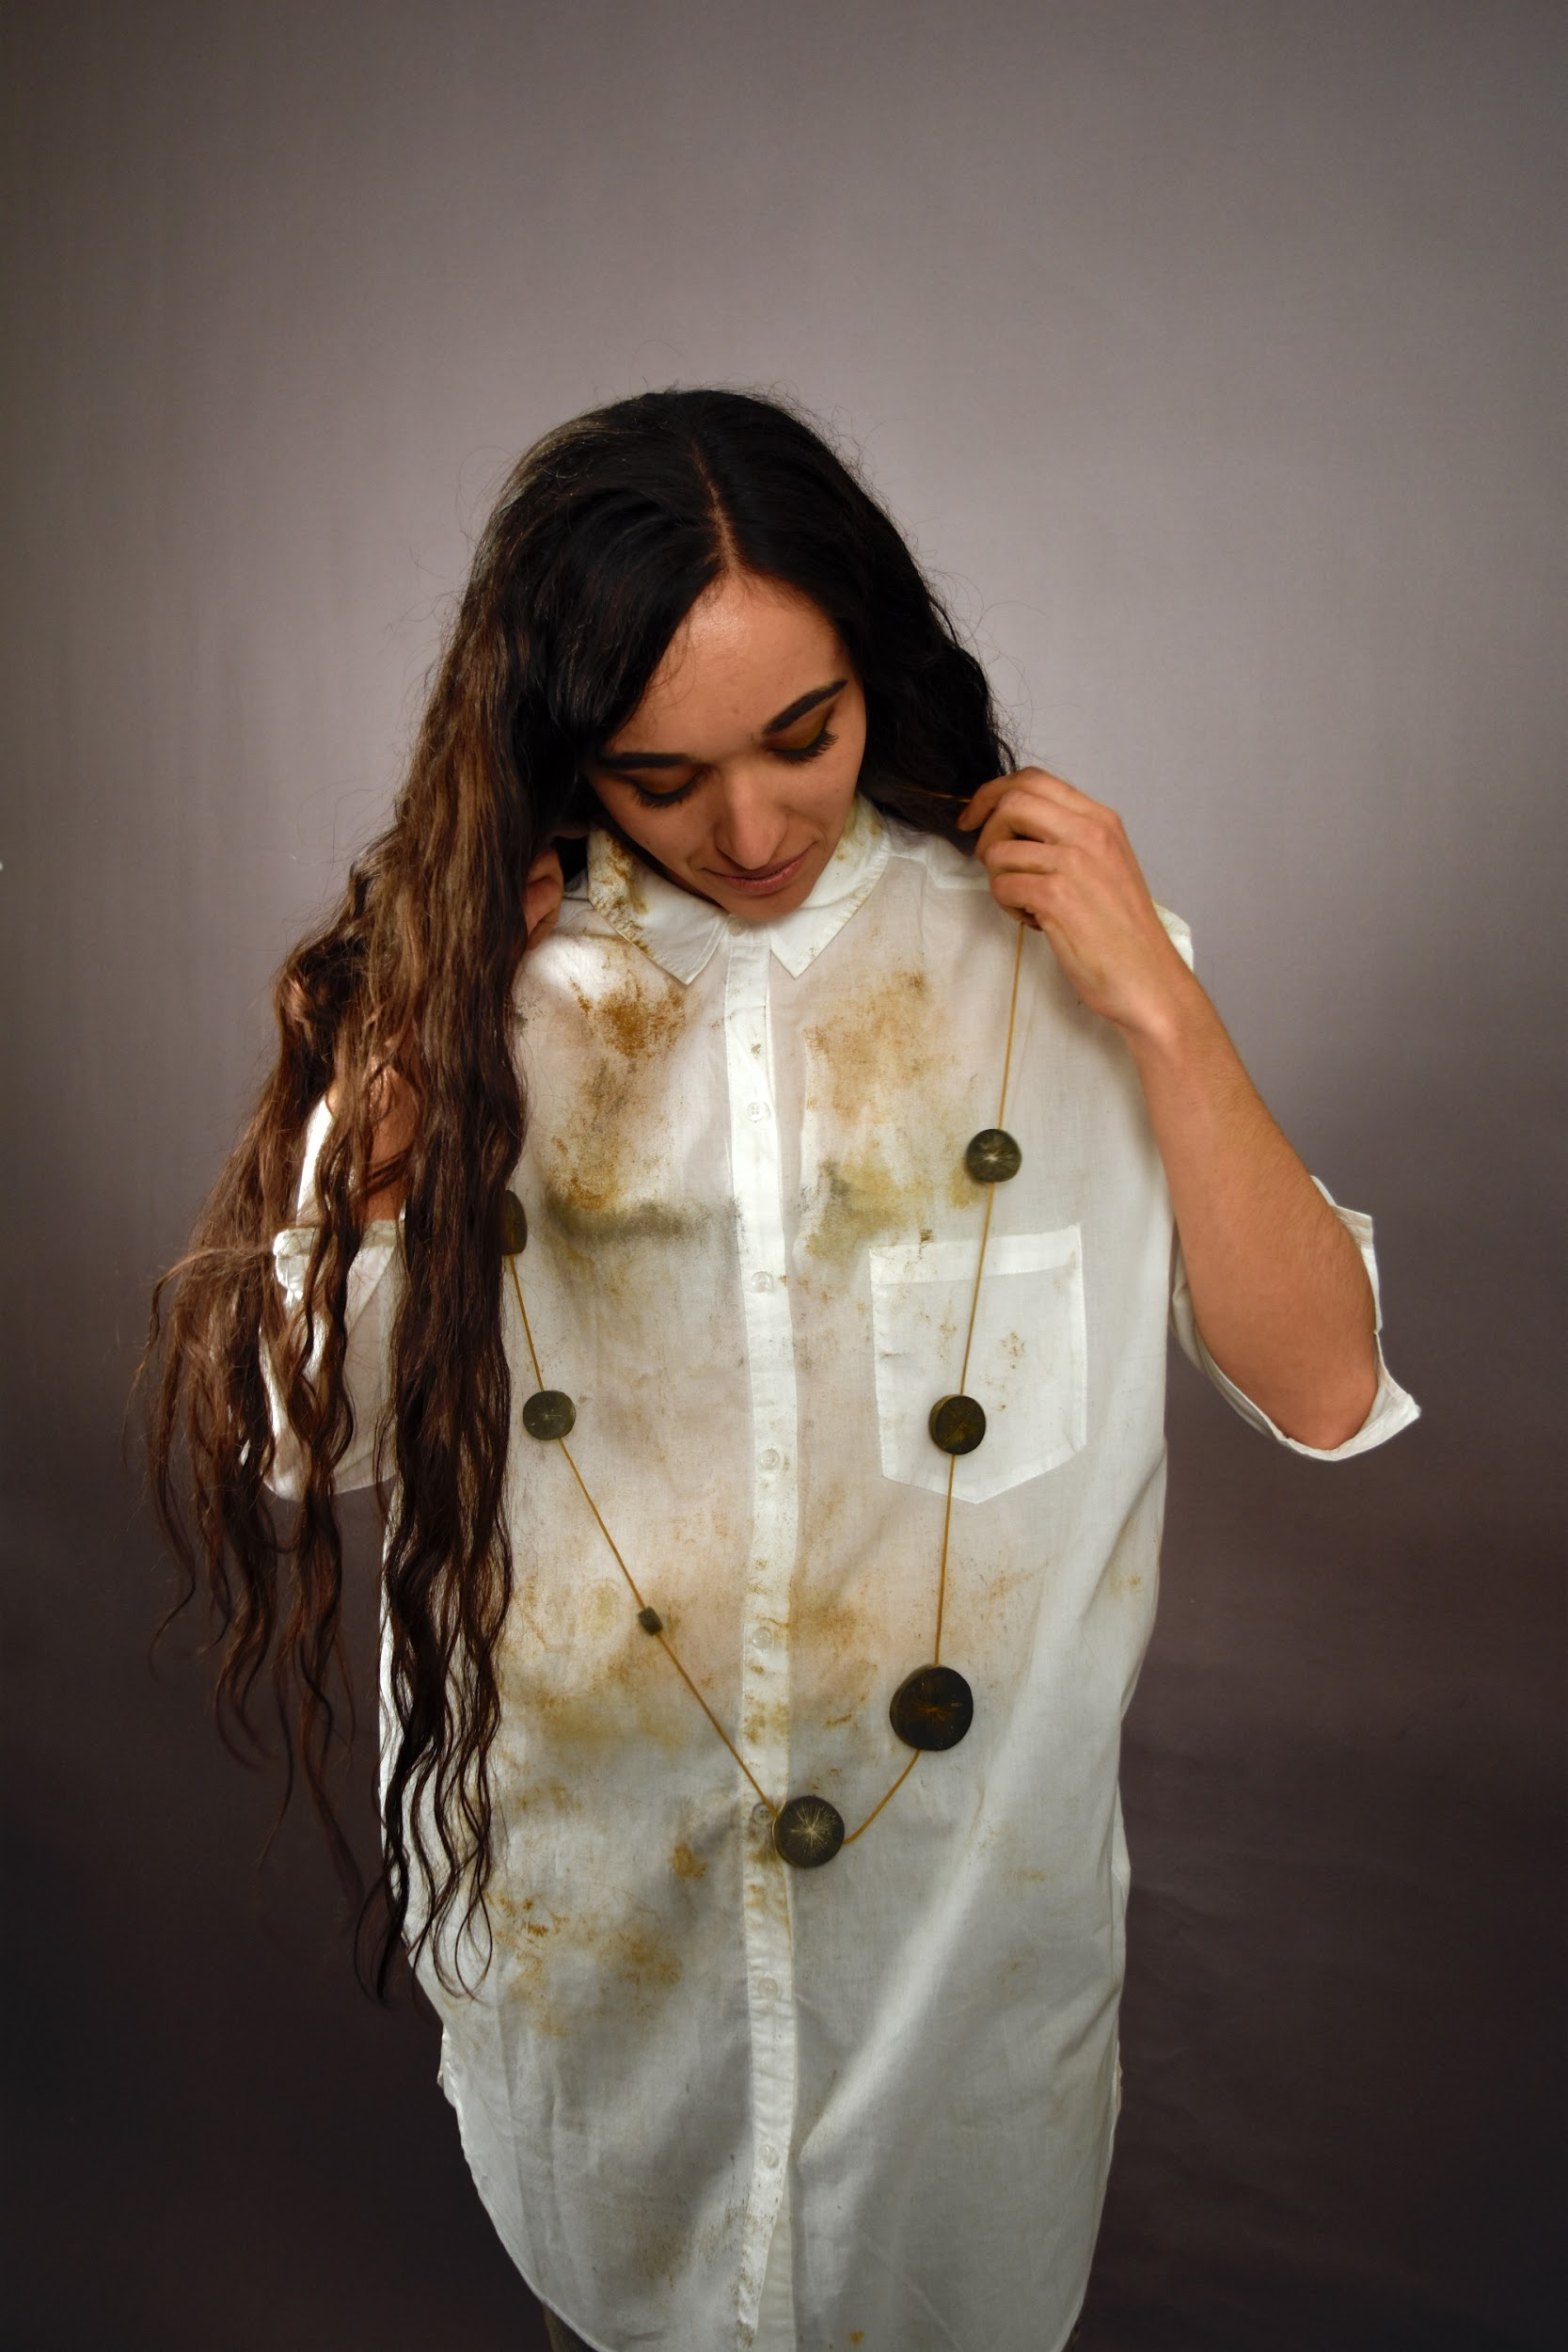
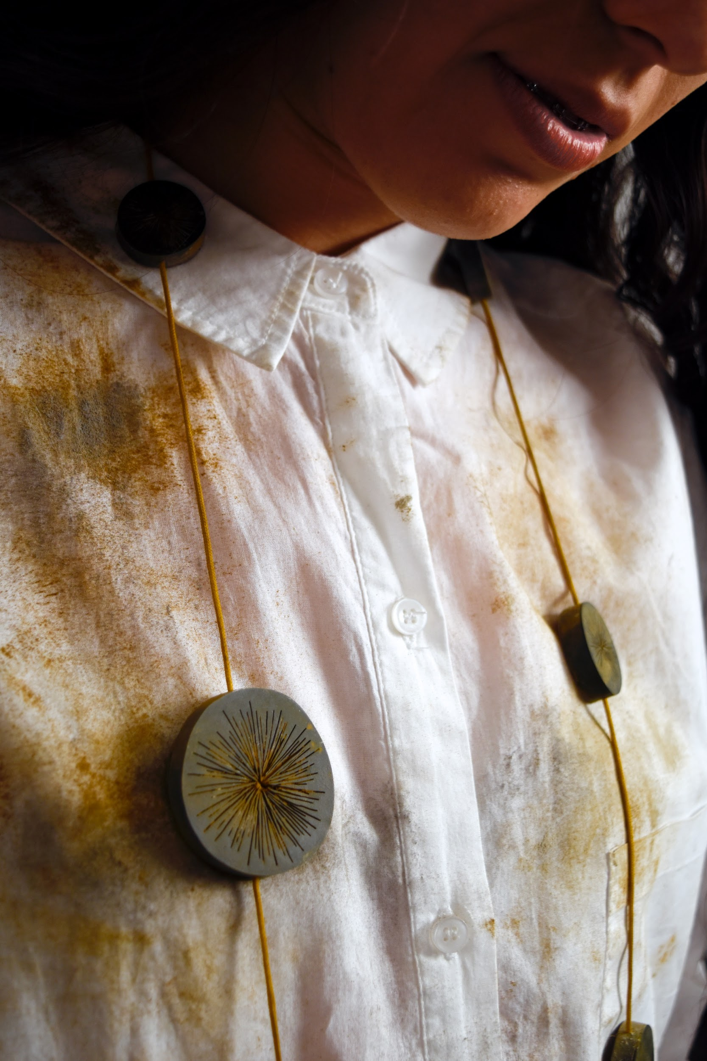
modeled vs object
Intricacy
Context
Relatable
Sandra Salaices 2016
Notes:
how intricate your piece? does a simple shot work? do you need detail shots?
A model may helps people give a sense of size look and feel.
Giving your piece context is important for you audience to understand your piece, specially for non-wearable work
A model can also help people relate and connect to your piece, increasing the chances of making a sale

Slide 14
artificial vs natural light
Light control
Lack of equipment
Time of day
Harsh shadows
Location
Nava 2020
Notes:
There are some advantages of using the sun as a tool, but not without some cons
Most notably white balance and shot temperature, depending on your piece it can be best to go for warmer tones, more easily achieved with natural light, or cold temperatures, with artificial light.
If you don’t have access to lighting equipment, you can set up outside, just be aware of how much time you have.
Depending of where you live between 11 and 1 are the best times for shooting outdoors
if shooting several pieces at a time be aware that light will change pretty quickly, a little cloud is all it takes, so for consistency try to keep your shoot short
Just check the weather and prepare yourself with the appropriate materials
If taking pictures of small pieces or jewelry, a simple background works best, just position it so the main light source is directly above or front of them depends on your piece
Be aware that taking pictures outside will produce harsh shadows since the only light source is the sun, but you can mitigate this by reflecting light with a screen or a piece of white paper
Image photographed with a mirrorless, camera, outside at 11am with a piece of paper background. Camera settings 1/400 shutter speed ISO 200 and f/16
Above image you can see the entire setup, just a piece of paper as a background,
notice the harsh shadow on the tail and how dark the back is.
Image below is the same setup taken immediately after, I simply lifted the piece of paper to curl around
notice the improvement on the back and the shadow is softer.
Compared to the phone picture from before, auto settings, piece of paper background, taken inside by a window.
None of these have been edited, simply cropped.
Again, it’s not the equipment, it’s how you use it

Slide 15
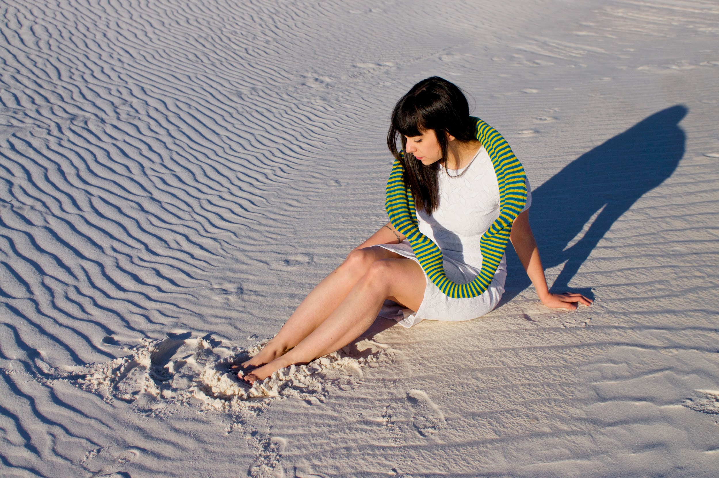
basic camera concepts
ISO
Shutter speed
F-Stop
Victor Beckmann 2016
Notes:
Boring stuff alert
If you have a DSLR or a mirrorless camera this is where having access to the settings starts paying off since you will be able to mess with them on manual mode
Depending on how bright the scene is you can control how much light the camera captures with
ISO,
shutter speed
and f/stop
ISO refers to the brightness sensitivity of your camera sensor, lower to mid ISO is best for sunlight, otherwise you will overexpose the image.
Higher ISO is useful for when the sources of light are very dim, however higher ISO is prone to grainess and noise
ISO ranges from 100 to 6400 usually
Shutter speed, refers to how fast the shutter opens and closes, kind of like opening and closing your eyes, for sunlight faster speeds are best to avoid overexposure
Similar to ISO longer exposures are better for dim environments, since it lets more light come in
Shutter speed is presented in seconds with faster speed presented as a fraction of a second
f/stop, refers to the size of the lens aperture, the aperture blades control how much light the lens makes available to the sensor.
F stop is presented as a fraction so f/8 means ⅛ and f/22 is 1/22, which means f/8 is a larger aperture than f/22
What does all of this means?
Light control
The better you can control how much light is available to the sensor the better your shot will come out.
My recommendation, play with these settings, but I recommend you play not with manual mode but start with other modes, depending on your camera model some shooting modes will automate the shot while still letting you you play with the aperture, shutter speed and f-stop
Sometimes they are called S, P or A modes, once you understand what these three things do, you can venture into manual mode

Slide 16
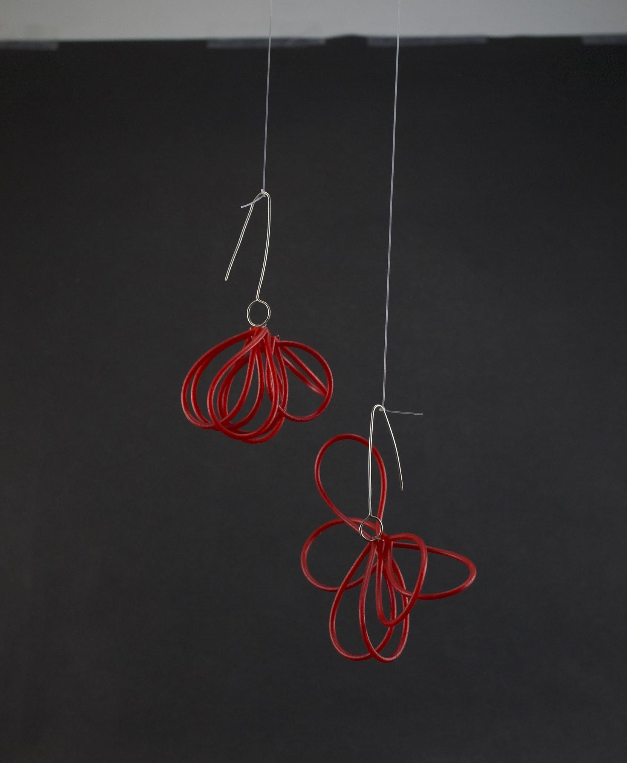
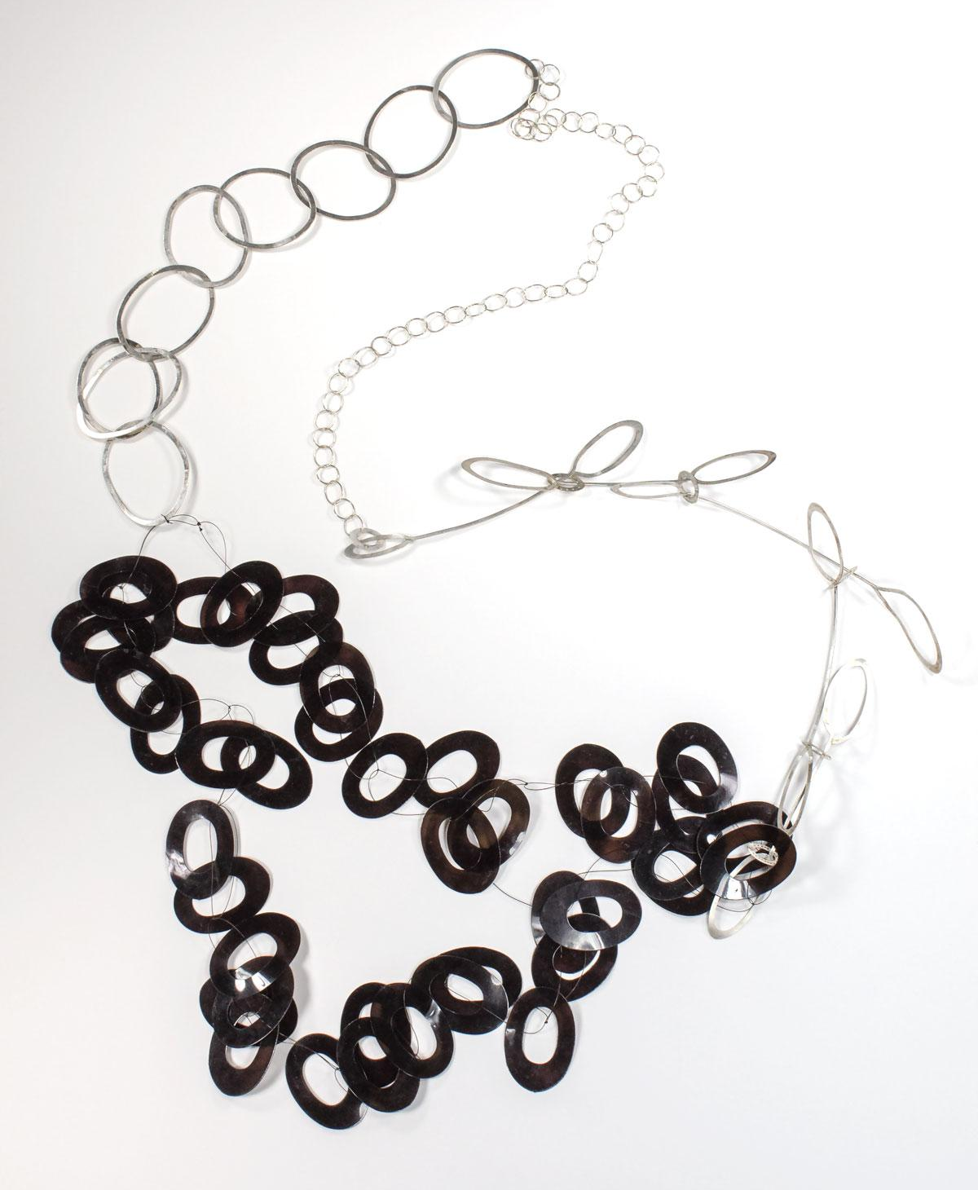
piece prep
Cleaning
Propping
Roll call
Schedule
Criselda Lopez 2019
Notes:
Pthe shot, both cameras and phones are smart enough to pick the best settings
so your job really is to make it easy for them to shoot a great image
That’s why we are taking the time to prepare everything in advance so all we have to do is press the shutter button once or twice
Part of the prep is taking care of your pieces, if your piece is dirty, has dust, visible fingerprints, all is going to show up once you get close on the photoshoot.
So inspect the pieces beforehand
Propping
how are the pieces going to be displayed? If it’s a ring is it going to stand up, laid out, on a hand?
Dangling earrings look the best when they are suspended, some necklaces look great laid out, some other you might need a bust, figure this out in advance.
Remember the tape, thumbtacks and fishing line on the accessories list? This is where you get to use all of that.
If taking pictures of several pieces, have a roll call, make a list of your pieces and the images you need from them, make sure to note how you will be propping them
During production is a lot easier to keep track of a list
If you are shooting with a model, you have to be aware of the time available, you have to be ready when the model is
If shooting at a specific location or several locations, best to make a plan and schedule time spent on each location
Do your homework, the more you prepare in advance the less you have to worry during the photoshoot and subsequently during editing

Slide 17
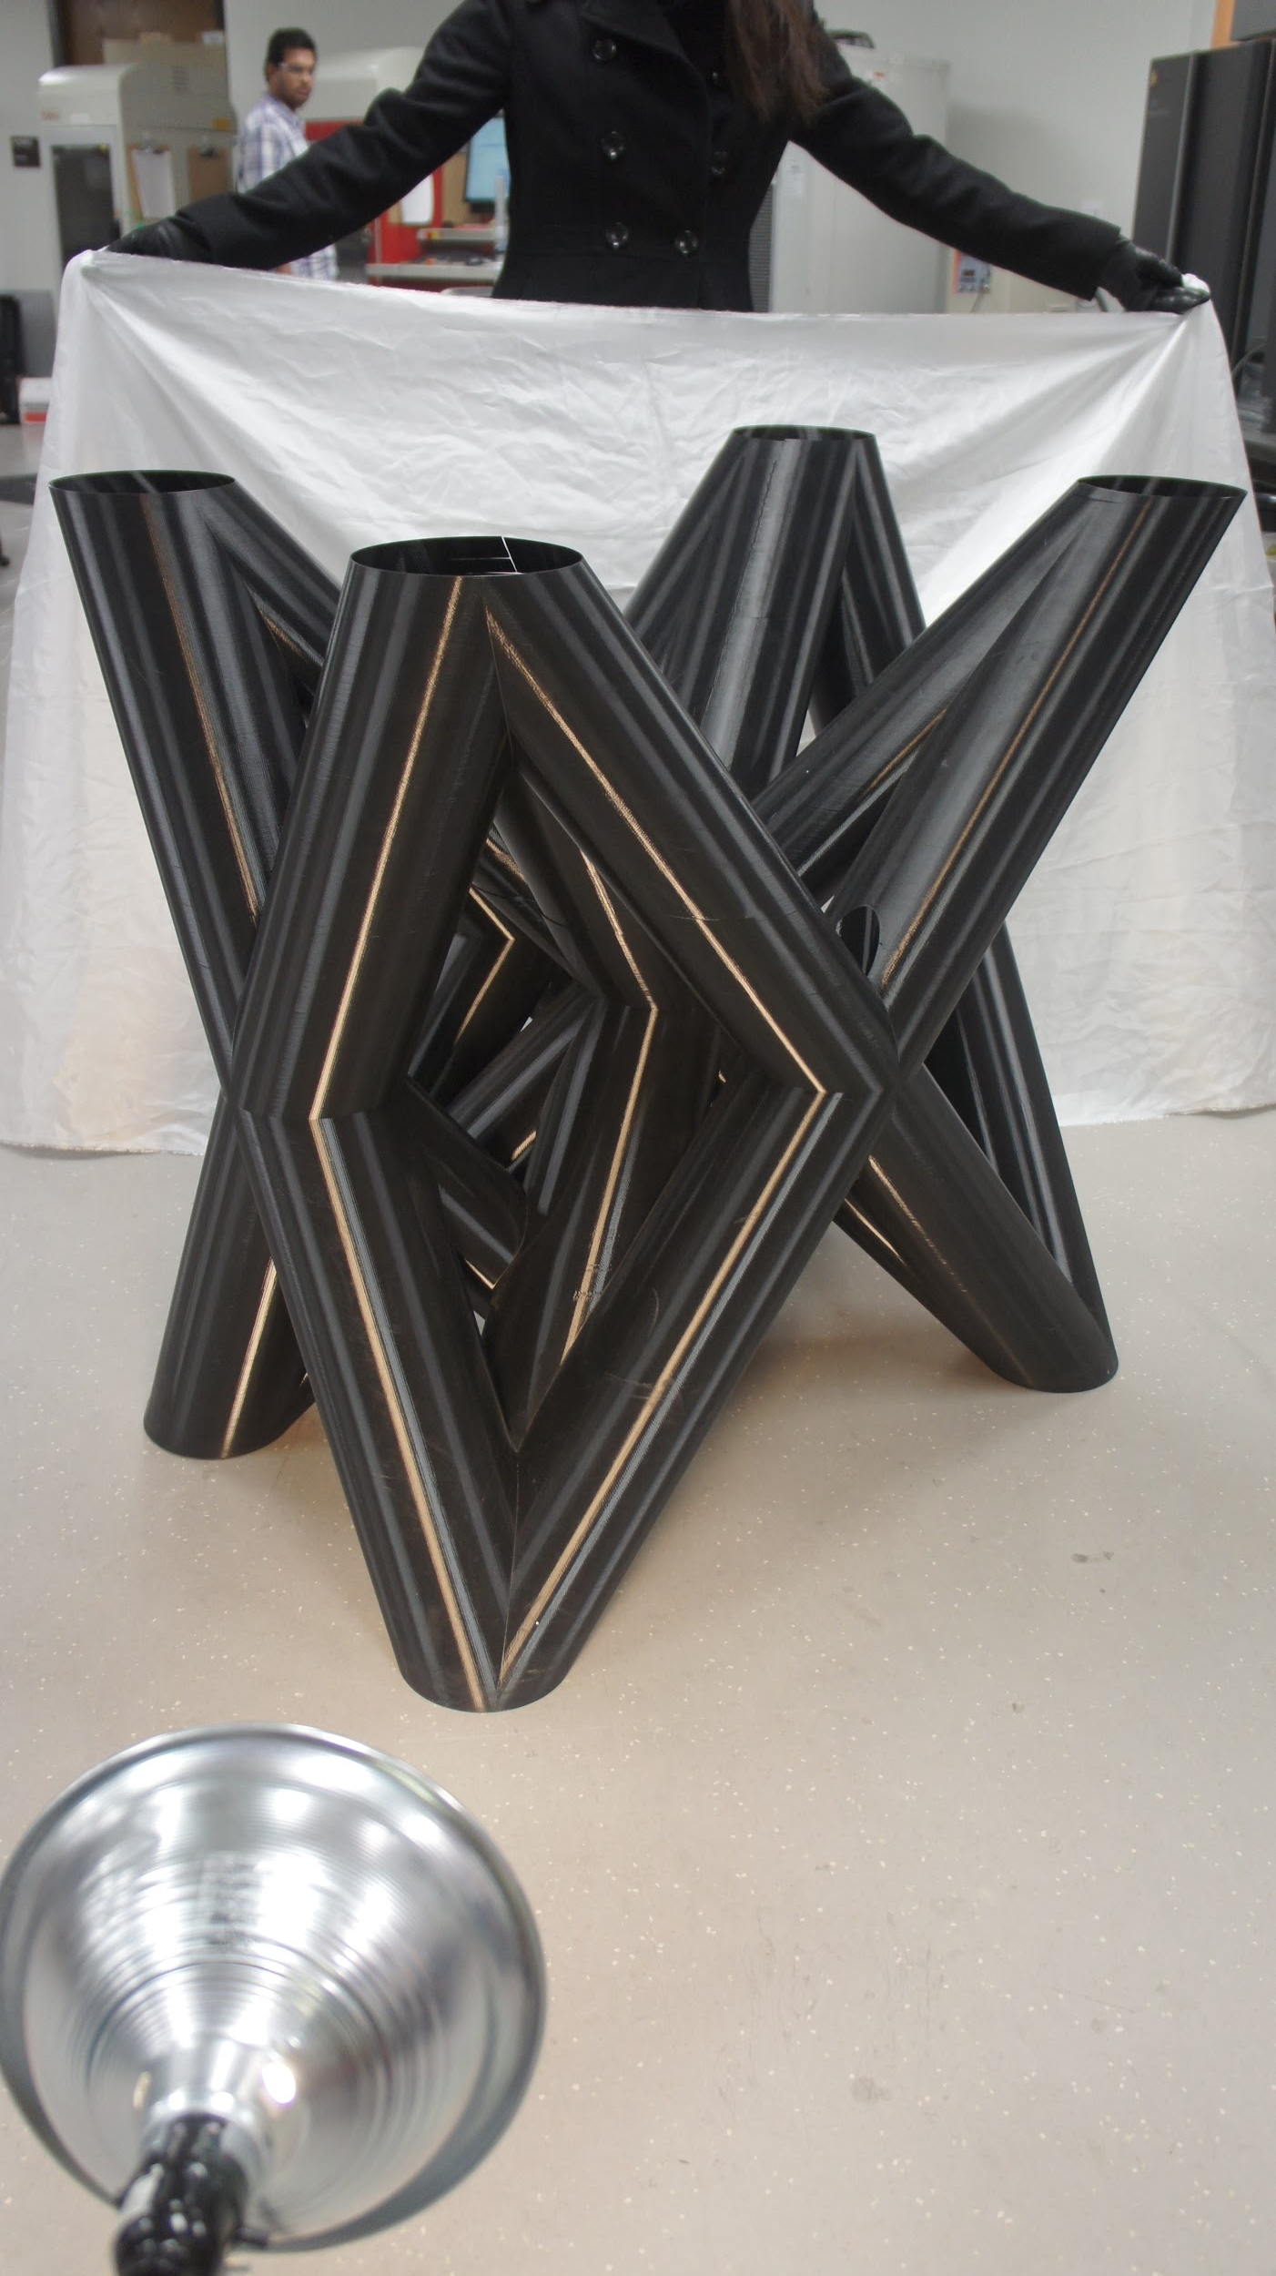
production
Before pressing the button
Click away
Murphy's law
W.M. Keck Center, UTEP 2015

Slide 18
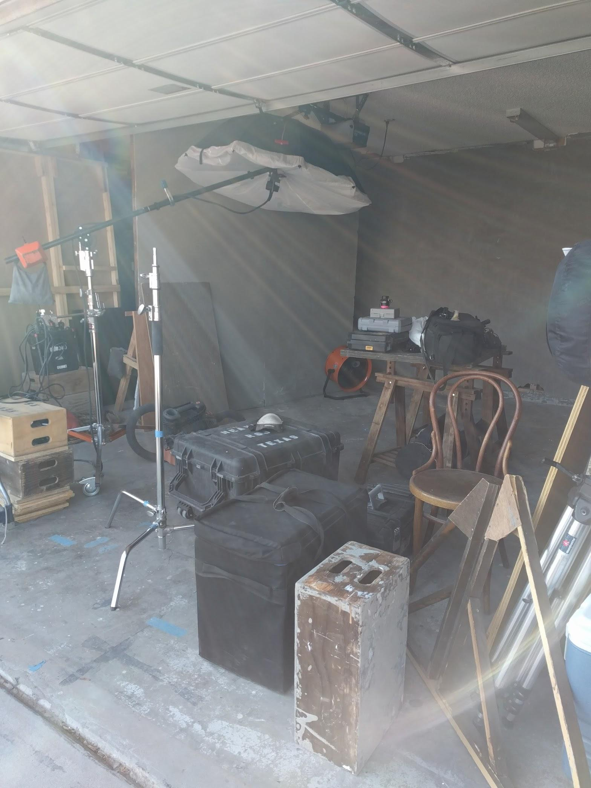
before pressing the button
Batteries
Camera settings
Memory card
Raw vs JPEG
Notes:
Remember to charge your batteries and devices, all the work will be for naught if your battery dies mid photoshoot.
If you are using a phone DO NOT charge and take pictures, specially outdoors.
Having the display on, image processing, you holding the phone, direct sunlight, these actions heat up your phone independently, charging accelerates heating
Doing it all at once will only cause your phone to shut down
If possible to get an extra battery for your DSLR or a wall adapter those can help if you are in a studio setting, otherwise, keep your shooting time short
Camera settings, if you did your job and played around with the settings in advance great, if not, stick with what you know
Memory card, same with the battery triple check, is it in the camera? has it been formatted? does the camera recognize it? A spare always helps sd cards are super cheap now
In the case of your phone, specially iphones, do you have enough storage? If not backup your family photos on the cloud and clear space do so BEFORE the photoshoot
Raw vs JPEG?
Raw format is an image that has not been processed by the camera.
Raw is useful if you plan on spending a good deal of time with color, white balance, and the whole deal of settings in post-production, since it offers more flexibility for editing
Double edge sword since it’s unprocessed, it will take a long time to edit the shot, good to practice on one or two, a pain if doing a series
JPEG is compressed processed and packaged format. In a camera that means that the engineers have tuned the camera to process photos and color in a certain way.
When you take a picture and the camera says processing, this it’s what it’s doing, tuning the shot and saving it as a jpeg.
JPEG is useful if you just plan on making small changes on post maybe some color correction
Most cameras offer Raw + JPEG modes, do not choose that, it literally saves the image twice so it fills up your memory in half the time, choose raw or jpeg ahead of time
Some newer phones and iphones have raw image settings, that let you fine tune the image to your liking
iPhone, Raw images on iphone are called DNG, and are often saved as a HEIC
HEIC is not a raw format, it’s their own JPEG codec, half the file size, same quality, double the pain, macs open it no problem, but you might encounter problems opening them anywhere else

Slide 19
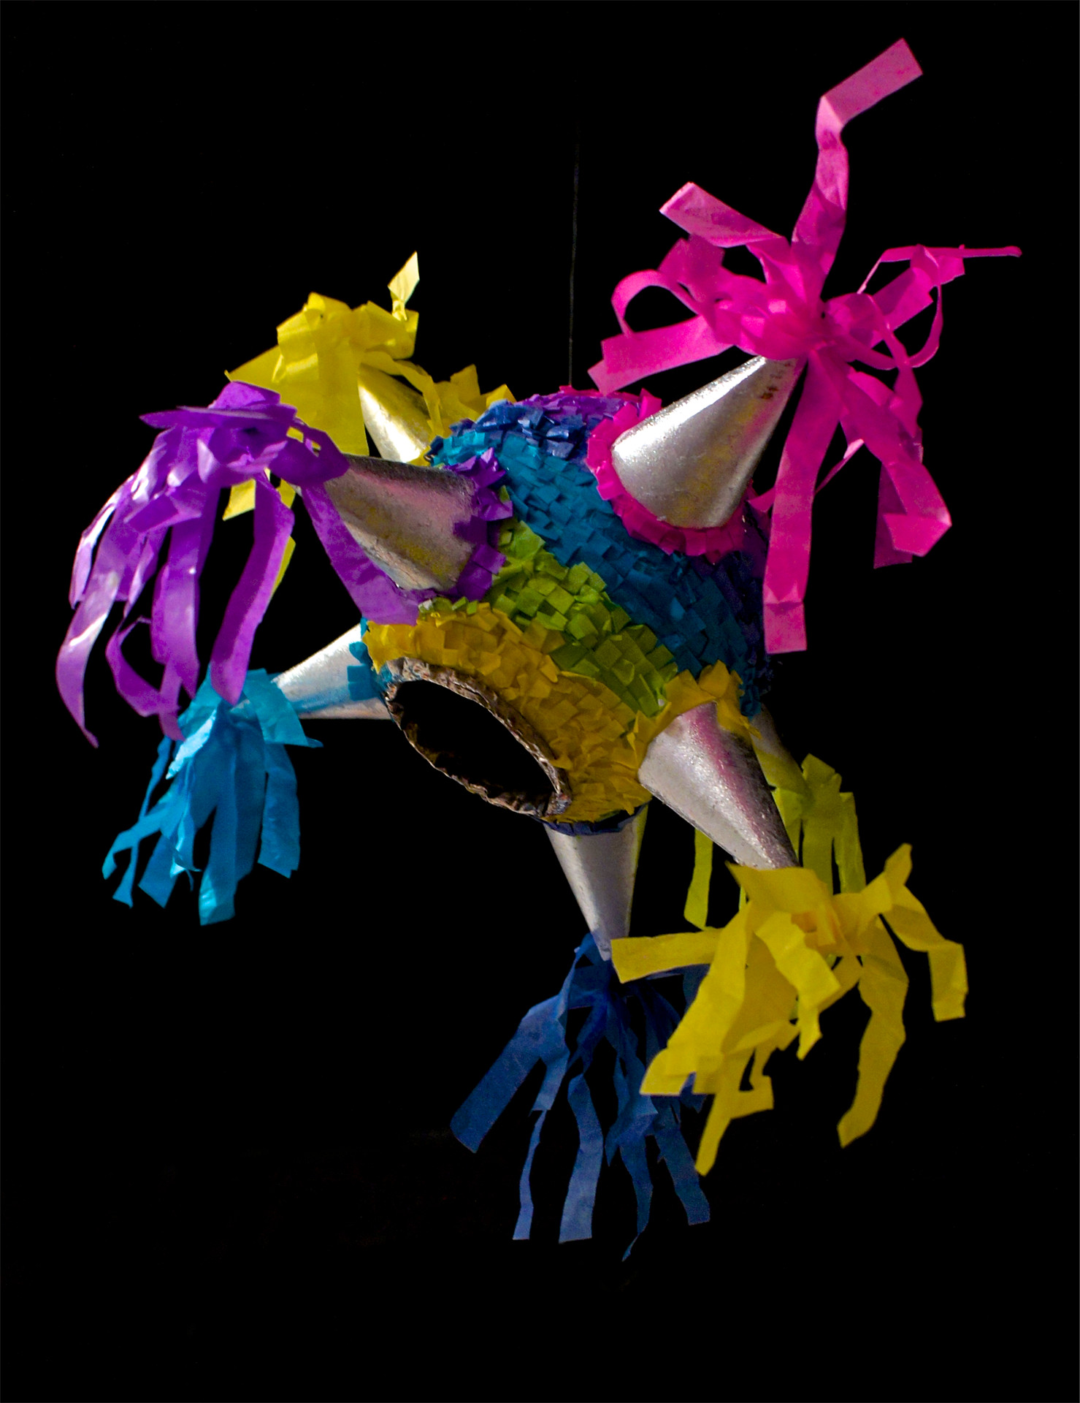
click away
Focus
White balance
The perfect shot
Quick preview
Jorge Calleja 2015
Notes:
Click away, just don’t go crazy, the more images you take, the harder will it be to find the right shot on post
Make sure the subject is in focus, that the image is not over exposed, but well lit
Check for for white balance, camera settings for sunlight or fluorescent light
Forget the idea of the perfect shot, you are looking for a great image to work with
If you are using a camera, don’t rely on the quick preview
the little screen is not tuned for color nor has enough resolution, phones are better for this
I recommend checking on your computer, if possible, once you understand your equipment it will be easier for you to INTERPRET the quick preview

Slide 20
murphy's law
No show
Equipment failure
Things are falling apart
Jorge Calleja 2015
Notes:
There’s really not much you can do, so just give yourself time if you have a deadline
Prepare to minimize a catastrophe
Be flexible be creative, find a solution
Don’t forget to breathe

Slide 21
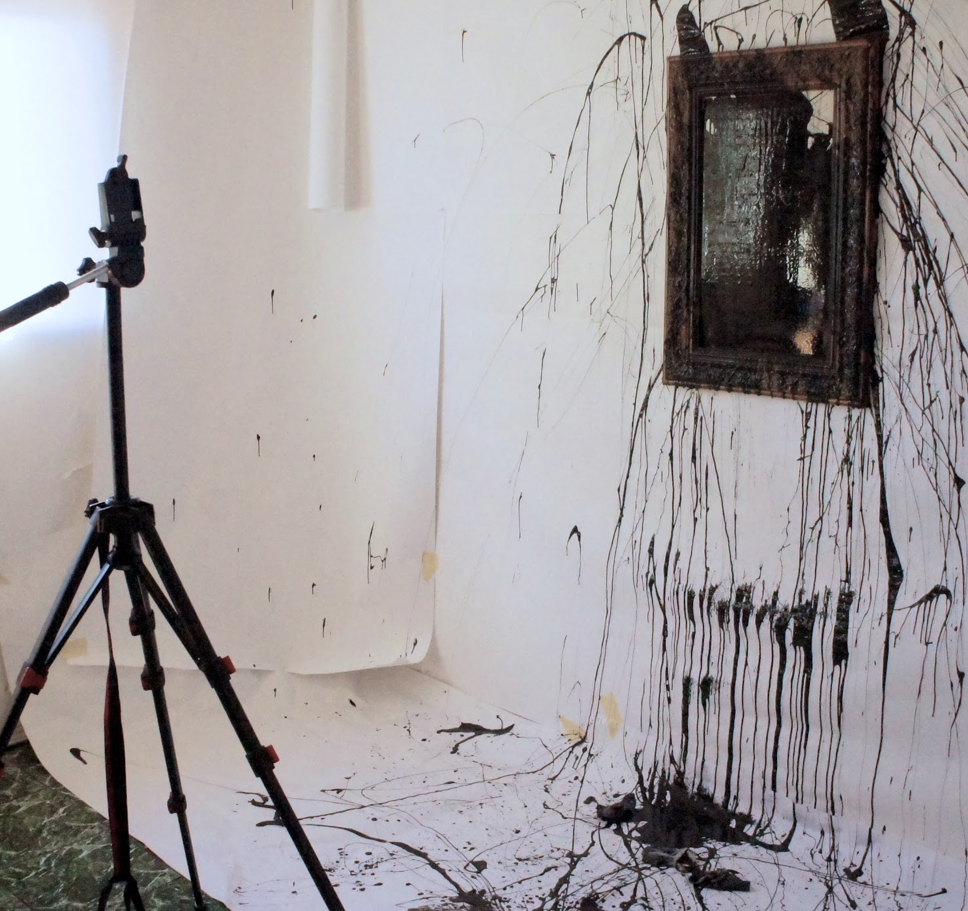
post-production
File management
Program
Retouching/Editing
Exporting

Slide 22
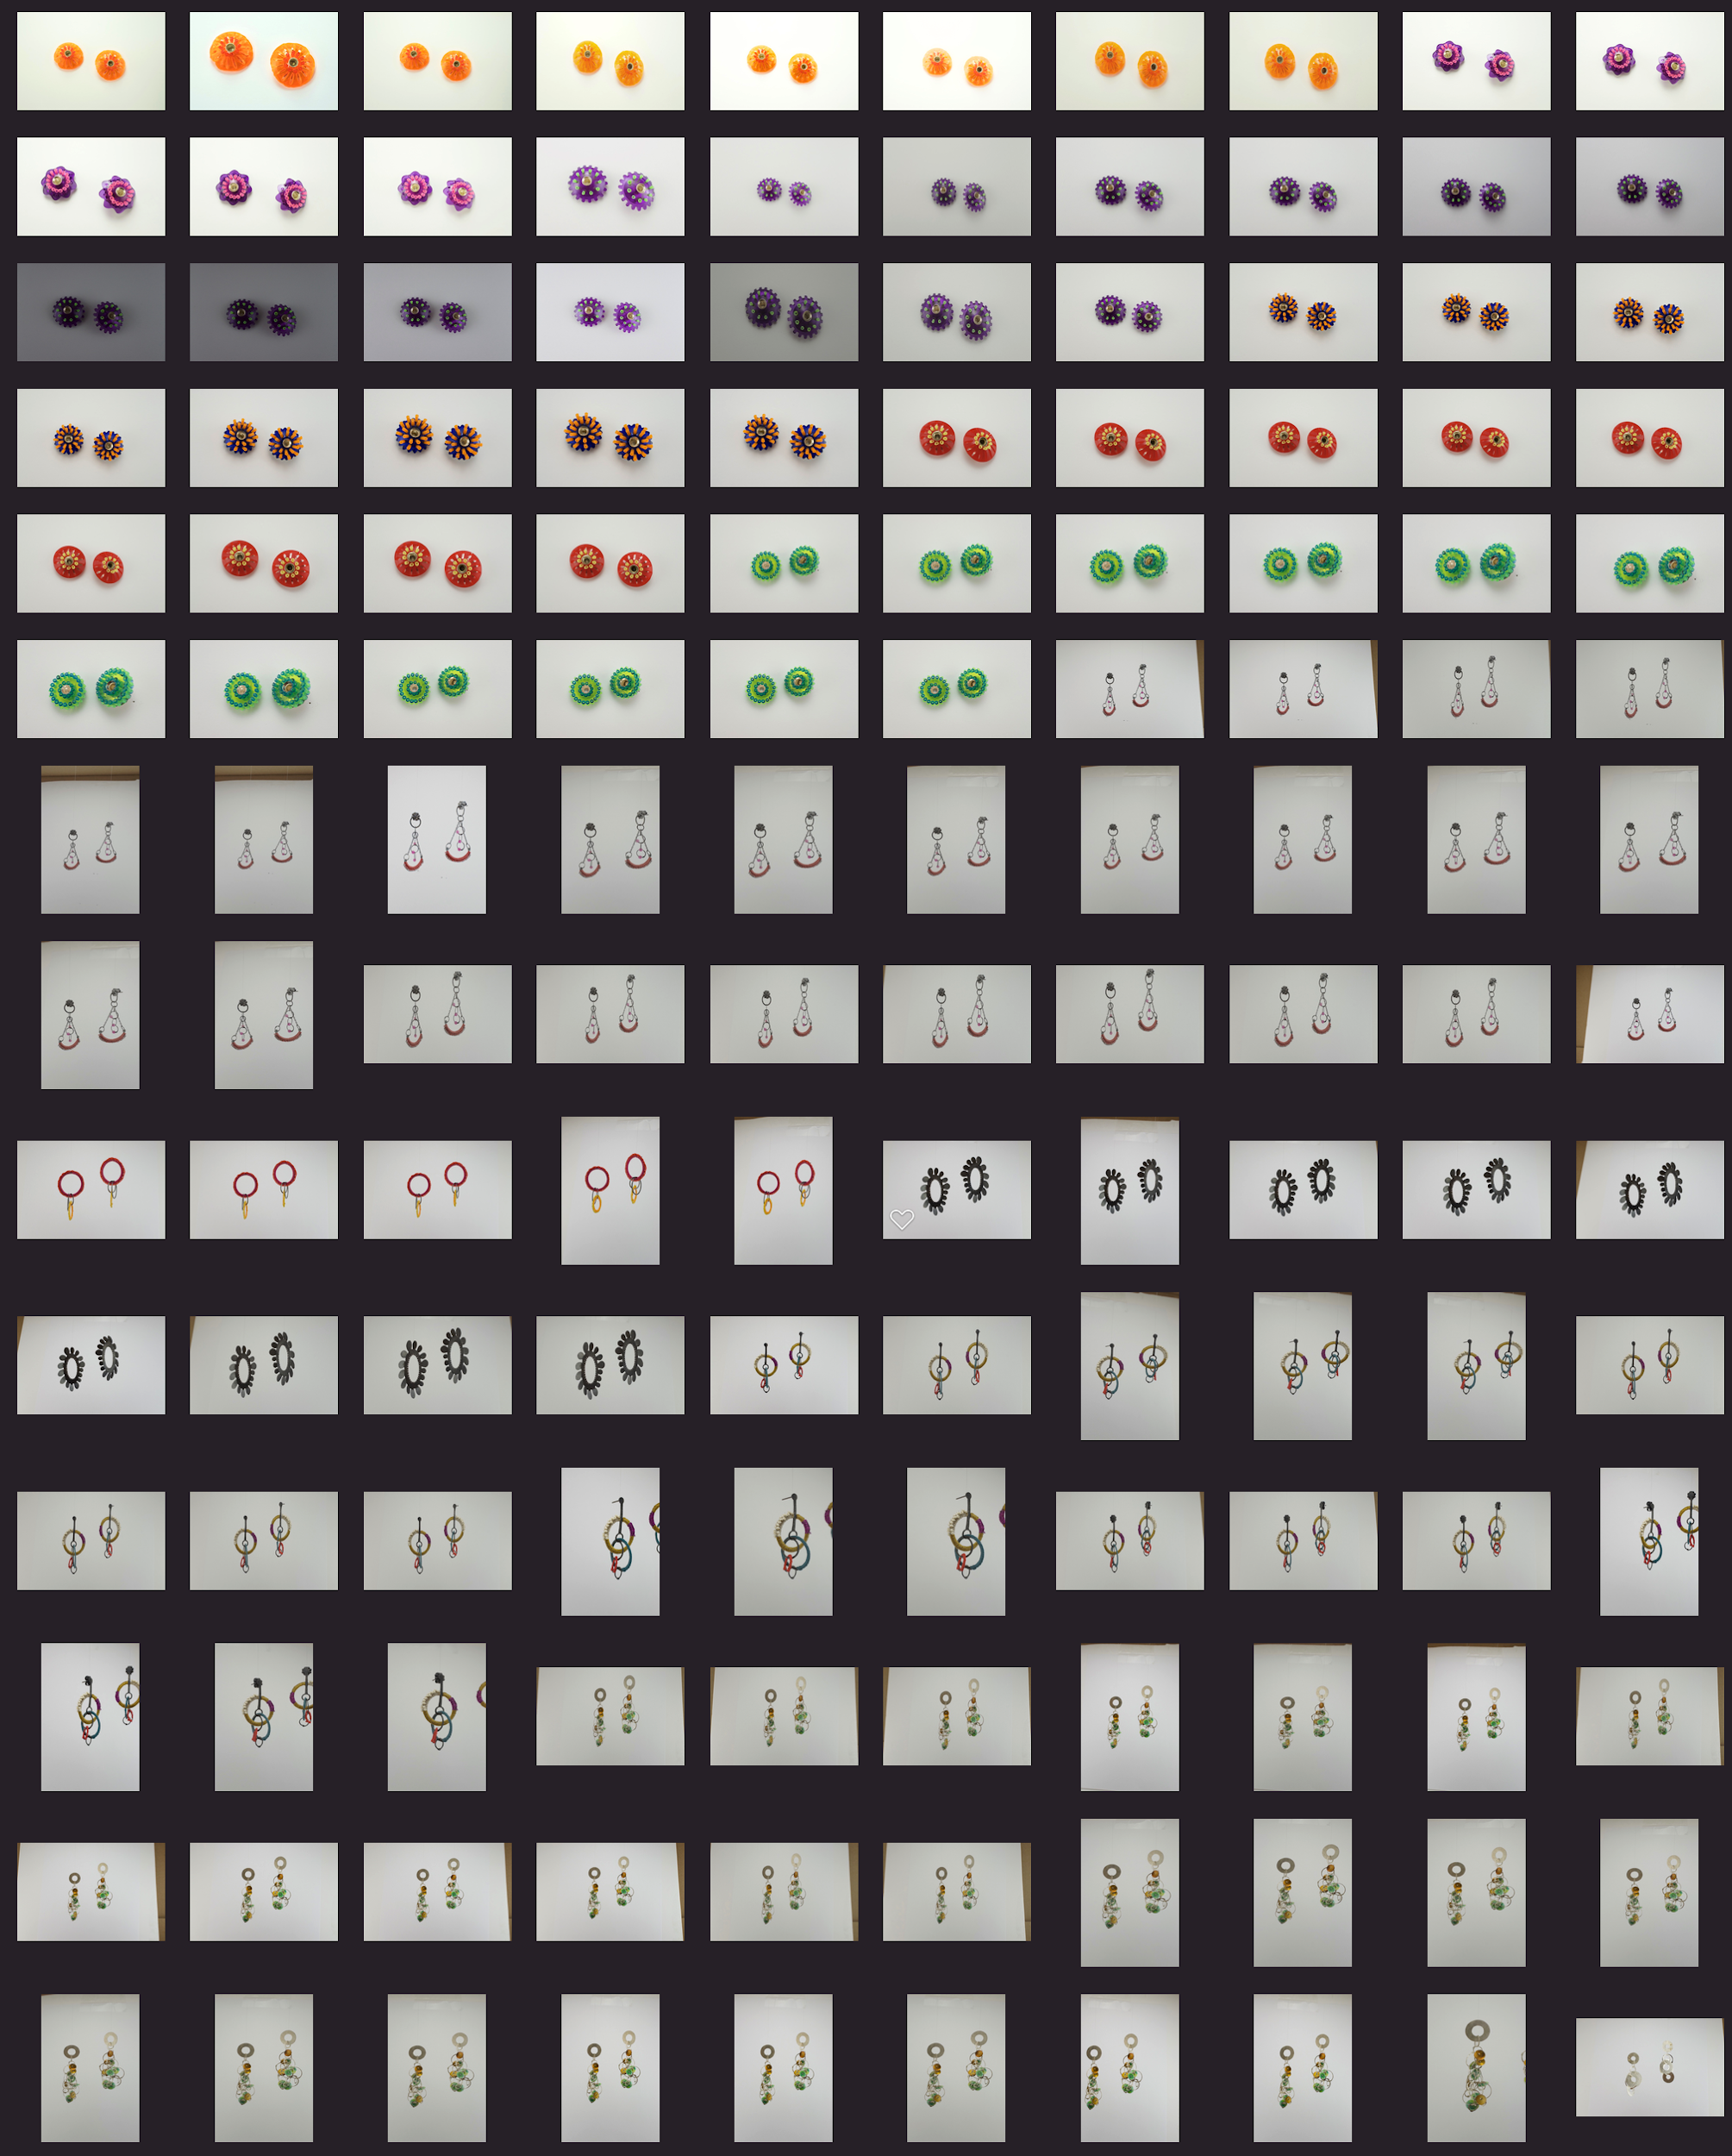
file management
Location
Naming
Library
Notes:
You should figure this out as soon as possible
Images start piling up if you are not careful
Where are these images stored?
Your computer, the cloud, an external drive?
Or are they going to live on your camera roll with your family and pet pictures?
Best to keep them separate
If you are just using a files and folders that’s fine
You don’t need to name absolutely every shot, but at least name the folder, makes it easier to find your shots
If you use Photos app on your apple computer you can always create a separate library by holding option key before opening the program
or you can use a photo management program

Slide 23
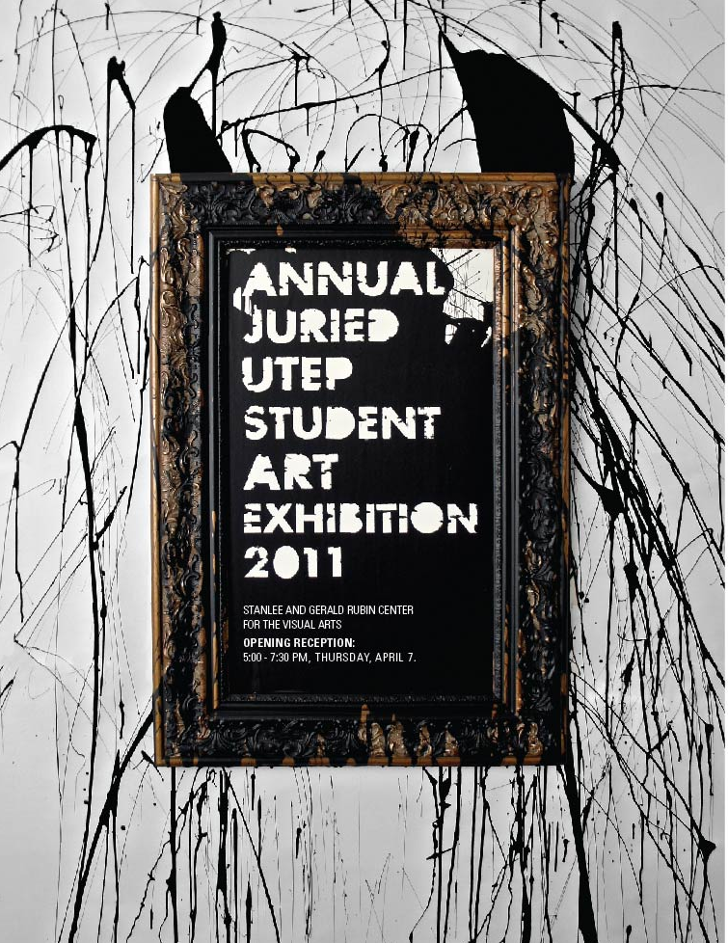
program
Lightroom vs Photoshop
Photos (iPhoto)
Web based
Phone
Jorge Calleja 2011
Notes:
Lightroom vs Photoshop
Lightroom is a specialized tool for photo adjustments and library management
So developing raw images and keeping your files organized
Lightroom classic which is best if you already know how to use it with a big focus on computer based editing
Lightroom CC is geared towards an online library with controls more reminiscent to those on mobile, so it seems more intuitive in phones and tablets
Photoshop is a image editor with a robust set of tools to edit every last detail of your image,
it includes camera raw which lets you open and tune the images before importing them to photoshop
Photos app on the mac is similar to Lightroom, it incorporates tools to adjust your photos and also provides library management tools
Again I recommend creating a separate library to avoid mixing with your personal photo library
there are plenty of free and web based alternatives, specially now that they are subscription based, they can get pretty expensive
On your phone you can use icloud or google photos to keep a clean library
I would recommend using a separate email account again, to avoid mixing work photos with personal photos

Slide 24
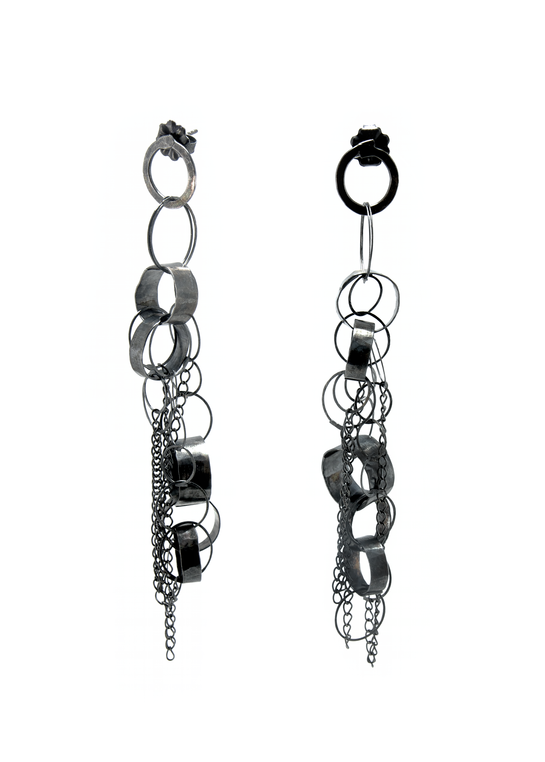
retouching/editing
Camera Raw
Imperfections
Background fixes
Adjustment layers
Brightness
Curves
Saturation/Hue
Helen Ellison Dorion 2015
Notes:
When shooting with camera, I tend to import to photos, choose the images I want to retouch and edit on photoshop
On Photoshop, regardless if I am working with Raw files or jpegs I retouch with Camera Raw for color and exposure
Once that has been done I move into fixing imperfections and background issues
Then start working with adjustment layers

Slide 25
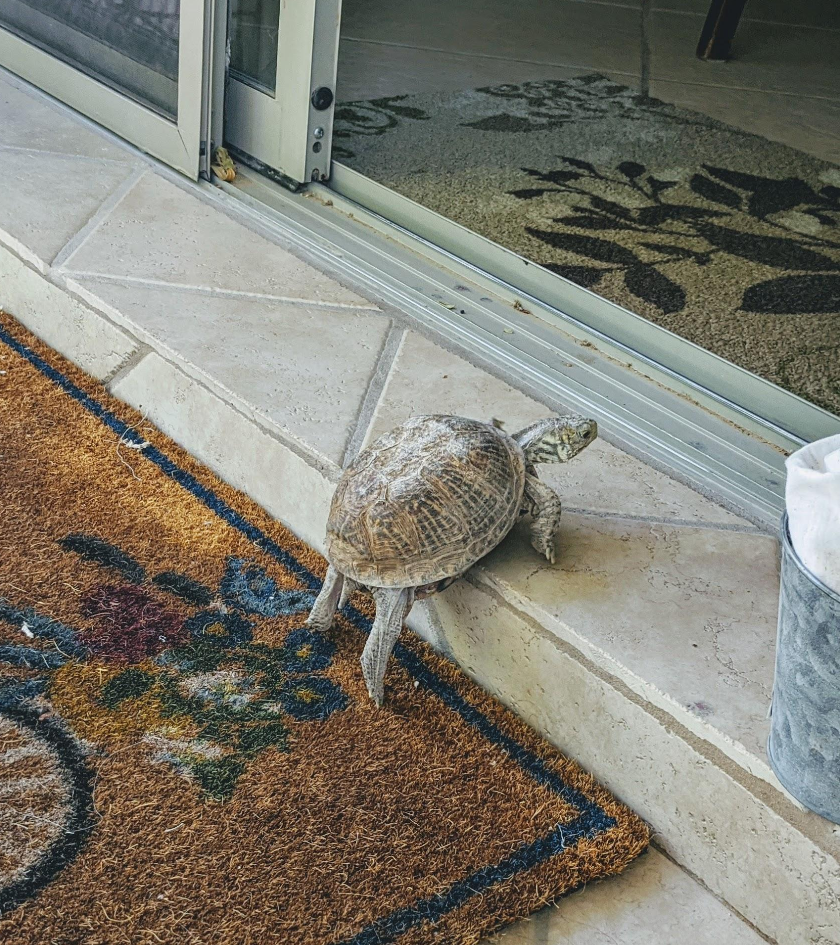
questions?

Slide 26
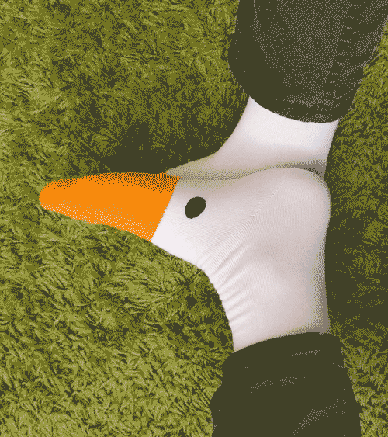
thank you

